Slide 1
Software Engineering
Topic 5:
Software Design
Your Name: _____________________
Computer Science & Engineering Department
The Chinese University of Hong Kong

Slide 2
Prelude
Software design should be based on s/w engineering principles
To apply principles, appropriate methods and techniques are needed
  Rigor and formality
    Rigor does not constrain creativity
    Appropriate notations for design
Notes:
In this topic, we discuss some important and general principles that are central to successful software development. These principles deal with both the process of software engineering and the final product. The right process will help produce the right product, but the desired product will also affect the choice of which process to use. A common problem in software engineering has been an emphasis on either the process or the product to the exclusion of the other. Both are important.
The principles we develop are general enough to be applicable throughout the process of software construction and management. Principles, however, are not sufficient to drive software development. In fact, they are general and abstract statements describing desirable properties of software processes and products. But, to apply principles, the software engineer should be equipped with appropriate methods and specific techniques that help incorporate the desired properties into processes and products.
Rigor and formality
Rigor does not need to constrain creativity. Rather, it can be used as a tool to enhance creativity: The engineer can be more confident of the results of a creative process after performing a rigorous assessment of those results. Paradoxically, rigor is an intuitive quality that cannot be defined in a rigorous way. Also, various degrees of rigor can be achieved. The highest degree is what we call formality. Thus, formality is a stronger requirement than rigor: It requires the software process to be driven and evaluated by mathematical laws.

Slide 3
Prelude
  Separation of concerns, Modularity, Abstraction
    Handle design complexity, make s/w understandable and reliable
  Anticipation of change, Incrementality
    Produce evolvable s/w design
  Generality
    Product family
Notes:
Separation of concerns
Separation of concerns allows us to deal with different aspects of a problem, so that we can concentrate on each individually. Separation of concerns is a commonsense practice that we try to follow in our everyday life to overcome the difficulties we encounter. The principle should be applied also in software development, to master its inherent complexity.
Modularity: A complex system may be divided into simpler pieces called modules. A system that is composed of modules is called modular. The main benefit of modularity is that it allows the principle of separation of concerns to be applied in two phases: when dealing with the details of each module in isolation (and ignoring details of other modules) and when dealing with the overall characteristics of all modules and their relationships in order to integrate them into a coherent system.
Abstraction: Abstraction is a fundamental technique for understanding and analyzing complex problems. In applying abstraction, we identify the important aspects of a phenomenon and ignore its details.
Anticipation of change
The ability of software to evolve does not happen by accident or out of sheer luck-it requires a special effort to anticipate how and where changes are likely to occur. Designers can try to identify likely future changes and take special care to make these changes easy to apply.
Incrementality: Incrementality characterizes a process that proceeds in a stepwise fashion, in increments. We try to achieve the desired goal by successively closer approximations to it. Each approximation is an increment over the previous one.
Generality
Every time you are asked to solve a problem, try to focus on the discovery of a more general problem that may be hidden behind the problem at hand. You end up designing a module that is invoked at more than one point of the application, rather than having several specialized solutions.

Slide 4
Prelude
High quality design
  modular structure
  decomposition criteria
Information hiding: a module is characterized by the information it hides from other modules ⇐ __clients___
  Information hiding + abstract data type
  ⇒ O-O design
  ___bottom-up__design
Stepwise refinement: __top-down__ design
Notes:
To achieve high quality of design, the software engineer must address two crucial and strictly related issues.
the engineer must provide a careful definition of the modular structure of the system——a definition that specifies the modules and their interrelationships.
the engineer must choose appropriate criteria for decomposing a system into modules.
A module is characterized by the information it hides from other modules, which are called its clients. The hidden information’ remains a secret of the client modules.
Information hiding is further analyzed and specialized to deal with the changeable nature of data, leading to the concept of abstract data types.
Further techniques supporting design for change are discussed
Stepwise refinement is technique produces software designs in a top-down manner, whereas information hiding proceeds mainly from the bottom up.

Slide 5
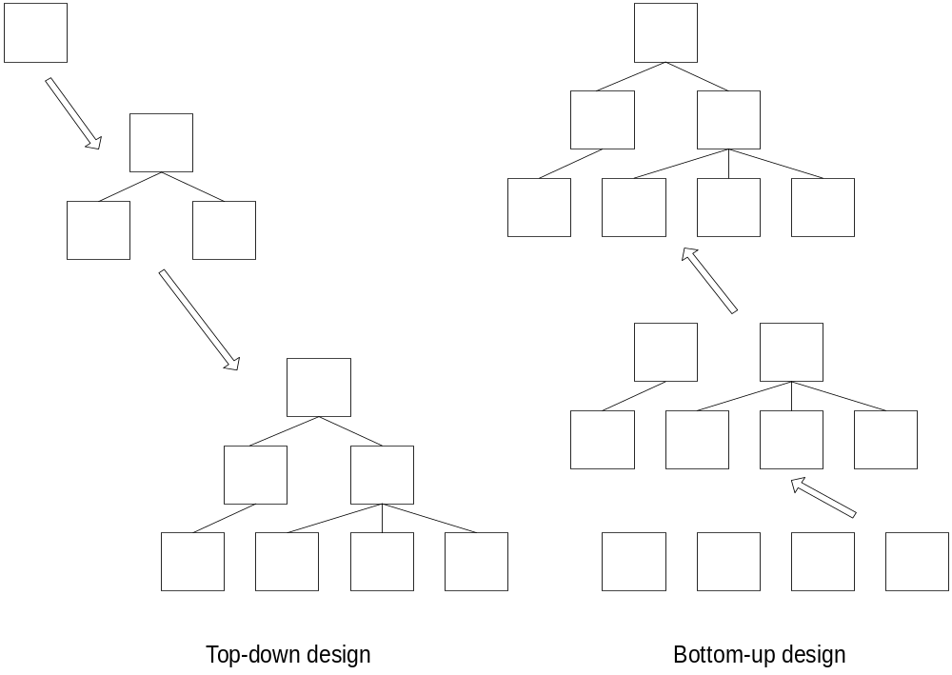
Top-down vs. Bottom-up Designs
Notes:
There are two ways of designing a software system, namely top-down and bottom-up.
A top-down approach (also known as stepwise design or deductive reasoning, and in many cases used as a synonym of analysis or decomposition) is essentially the breaking down of a system to gain insight into its compositional sub-systems. In a top-down approach an overview of the system is formulated, specifying but not detailing any first-level subsystems. Each subsystem is then refined in yet greater detail, sometimes in many additional subsystem levels, until the entire specification is reduced to base elements. A top-down model is often specified with the assistance of "black boxes", these make it easier to manipulate. However, black boxes may fail to elucidate elementary mechanisms or be detailed enough to realistically validate the model. Top down approach starts with the big picture. It breaks down from there into smaller segments.
A bottom-up approach (also known as inductive reasoning, and in many cases used as a synonym of synthesis) is the piecing together of systems to give rise to grander systems, thus making the original systems sub-systems of the emergent system. Bottom-up processing is a type of information processing based on incoming data from the environment to form a perception. Information enters the eyes in one direction (input), and is then turned into an image by the brain that can be interpreted and recognized as a perception (output). In a bottom-up approach the individual base elements of the system are first specified in great detail. These elements are then linked together to form larger subsystems, which then in turn are linked, sometimes in many levels, until a complete top-level system is formed. This strategy often resembles a "seed" model, whereby the beginnings are small but eventually grow in complexity and completeness. However, "organic strategies" may result in a tangle of elements and subsystems, developed in isolation and subject to local optimization as opposed to meeting a global purpose.

Slide 6
Software Design
Software design is an ___interactive___ process through which requirements are translated into a “blueprint” for constructing the software.
Initially, the blueprint depicts a holistic view of software, i.e., the design is represented at a high-level of ___abstraction___.
Throughout the design process, software evolves with more details, while maintaining software quality.
Notes:
Software design is an interactive process through which requirements are translated into a “blueprint” for constructing the software.
Initially, the blueprint depicts a holistic view of software, i.e., the design is represented at a high-level of abstraction.
Throughout the design process, software evolves with more details, while maintaining software quality. The quality of the evolving design is assessed with a series of formal technique reviews or design walkthroughs.
Three characteristics serve as a guide for the evaluation of a good design:
The design must implement all of the explicit requirements contained in the analysis model, and it must accommodate all of the implicit requirements desired by the customer.
The design must be a readable, understandable guide for those who generate code and for those who test and subsequently support the software.
The design should provide a complete picture of the software, addressing the data, functional, and behavioral domains from an implementation perspective.
5-<number>

Slide 7
Process of Software Design
During the design process, the software specifications are transformed into design models.
Models describe the details of ____data____ structures, system __architecture___, _interface_, and _components(procedure)__.
Each design product is reviewed for quality before moving to the next phase of software development.
Notes:
During the design process, the software specifications are transformed into design models.
Models describe the details of data structures, system architecture, interface, and components (procedures).
Each design product is reviewed for quality before moving to the next phase of software development.
5-<number>

Slide 8
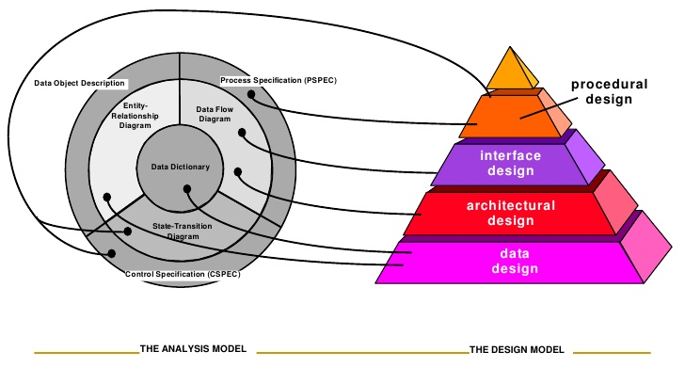
From the Specification Models to the Design Models
Notes:
Software design is the last software engineering action within the modeling activity and sets the stage for construction (code generation and testing).
The flow of information during software design is illustrated in this Figure. The analysis model, manifested by Process Specification (PSPEC), Control Specification (CSPEC), and Data Object Description, feed the design task.
PSPEC builds on DFD. CSPEC builds on State Transition Diagrams (e.g., FSM and PN). Data Object Description builds on ER Diagram. Their common core is Data Dictionary.
5-<number>

Slide 9
Design Description Models
Data design – created by transforming the analysis information (data dictionary and __ER diagrams__) into data structures required to design the software.
Architectural design – defines the relationships among the major structural elements of the software, and the constraints that affect the relationships. It is derived from _DFDs and other spec_ which specify and analyze the system and the subsystem interactions.
Notes:
Data design – created by transforming the analysis information (data dictionary and ERD) into data structures required to design the software. Part of the data design may occur in conjunction with the design of software architecture. More detailed data design occurs as each software component is designed.
Architectural design – defines the relationships among the major structural elements of the software, the architectural styles and “design patterns” that can be used to achieve the requirements defined for the system, and the constraints that affect the way in which the architectural patterns can be applied. It is derived from the system specification, the analysis model, and the subsystem interactions defined in the analysis model. The above are often already described by DFD.
5-<number>

Slide 10
Design Description Models
Interface design – describes how the software elements communicate with each other, with other systems, and with human users. ___DFDs___ provide much of the information.
Procedural / Component-level design – created by transforming the structural elements defined by software architecture into procedural descriptions of software components using process spec., control spec., and state transition diagram (___FSMs___, ____PNs____)
Notes:
The interface design describes how the software communicates with systems that interpolate with it, and with humans who use it. An interface implies a flow of information (data, and or control) and a specific type of behavior.
The component-level design transforms structural elements of the software architecture into a procedural description of software components, using process specification., control specification, and state transition diagrams (such as FSM,PN)
The importance of software design can be stated with a single word – quality. Design is the place where quality is fostered in software engineering. Design provides us with representations of software that can be assessed for quality. Design is the only way that we can accurately translate a customer’s requirements into a finished software product or system.
5-<number>

Slide 11
Software Design Activity
Software design is modularization:
system decomposition into __modules___
Description of
  functions of each module => intra-module
  interfaces between modules => inter-module
  ⇒ the software structure (architecture)
Notes:
We define a software design as a system decomposition into mdules—a description of what each module is intended to do and of the relationship among the modules. This is also known as software modularization.
The architecture shows the gross structure and organization of the system to be defined. A description of a software architecture includes a description of the main components of a system, the relationships among those components, the rationale used for the decomposition of the system into its components, and the constraints that must be respected by any design of the components.

Slide 12
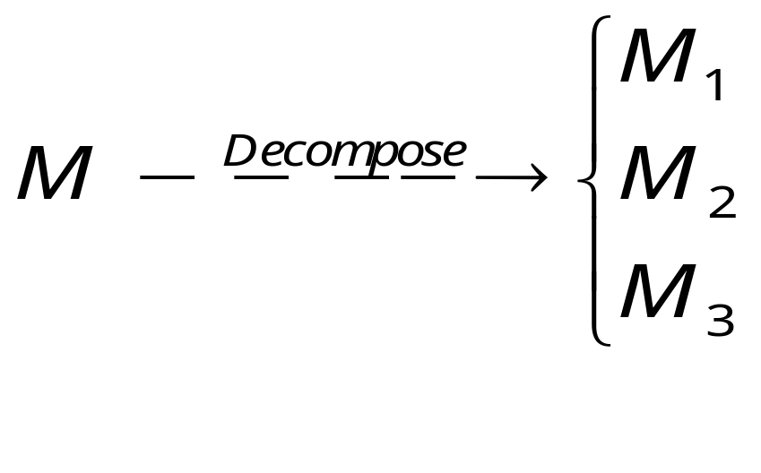
Software Design Activity
Implement
Implement
Design for change
  A design that is flexible enough to accommodate changes easily
  e.g. “__#define__” for constant names in C
Notes:
When a module M is decomposed into other modules, we say that these are used to implement M. Thus, in this approach, implementation is perfonned by recursively decomposing (sub)modules into modules, until we reach the point where implementation can be done in terms of a, programming language in a straightforward way.
Design for change promotes a design that is flexible enough to accommodate changes easily. This, however, cannot be achieved in general, for every type of change. Special care in the initial phase is necessary to anticipate likely changes when the requirements for software are stated.

Slide 13
What Changes?
1. Change of algorithms
  to improve efficiency, generality
  e.g. sorting algorithm (__simple__ → _complex__)
2. Change of data structure ( 17% of maintenance cost)
  e.g., arrays vs linked lists
  e.g., Data structures representing a Tree
Notes:
Change of algorithms:
This change is probably the best-understood type of change. that we can apply to software: To improve the efficiency of some part, to deal with a more general case, etc.
Change of data representation:
The efficiency of a program can change dramatically if one changes the structure used to represent some relevant data.
Typically, inserting an element into an array is costly if array entries are to be kept sorted according to, say, increasing index values. In fact, inserting an element at position i must be preceded by an operation that shifts all the elements at positions. It is not needed if we choose a linked-list implementation of the table.
One more example of data structure representing a tree is found in next two slides.

Slide 14
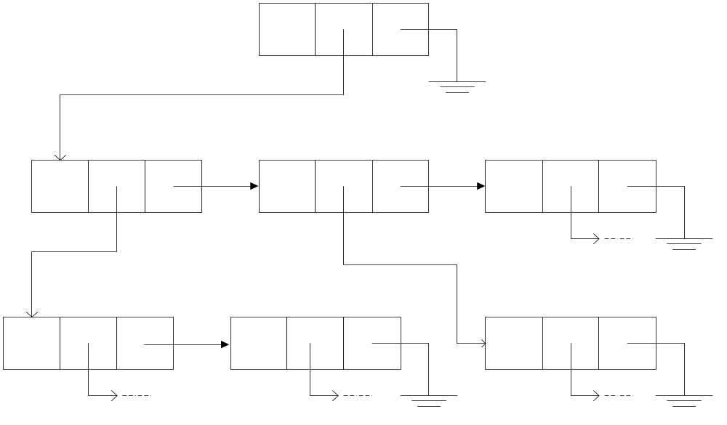
Data Structure Representing a Tree (1)
Q1: What is this tree?
A1: A binary tree
Q2: What is the main advantage of a binary tree over a predictable structure
A2: Simpler, more predictable structure
Q3: How to convert a general tree to a binary tree?
A3: for any node, left-link --> first child
right-link → next sibling
Notes:
Another example is a tree data structure, implemented via pointers. Each node of the tree has two pointer fields, one pointing to its right sibling, if any, the other pointing to its first direct descendant, if any.

Slide 15
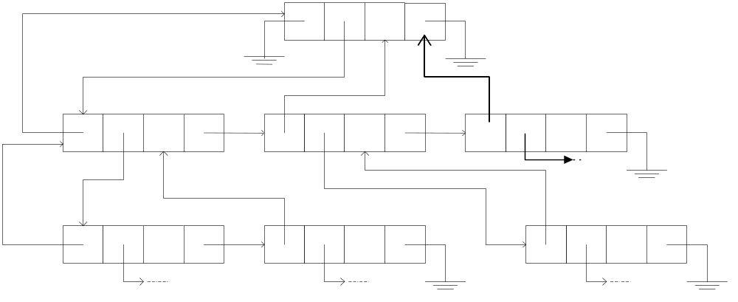
Data Structure Representing a Tree (2)
In this representation, a link is added to each node for easy return to parent.
Q: What is the main purpose?
A: efficiency in algorithm traversing
Notes:
One more pointer may be added to make it easier (i.e., more efficient) to move along the data structure from the leaves towards the root of the tree. The pointer we add connects any node to its parent node, if there is any.

Slide 16
What Changes?
3. Change of underlying abstract machine
  Hides details of the underlying h/w
  e.g. complier, database, OS
4. Change of peripheral devices
  e.g. printers, terminals, embedded applications
5. Change of social environment
  e.g. tax, social habits, currency changes
Notes:
Change of underlying abstract machine.
‘ The programs’ we write are run by some abstract (or virtual) machine, The machine coincides with the hardware in the (happily unlikely) case where no higher level languages are available for programming.
new releases of the compiler we use may be available, and the new version might perform additional optimizations in order to generate faster and smaller object code. Or there might be a new version of the database management system (DBMS) that saves disk space and offers improved functions in terms of protection from undesired access and recovery from failures.
Sadly, the benefits do not come for free. For example, if the new DBMS is able to store our data in half the original space, we have to reformat our existing databases We may also have to change our data access programs to take advantage of the saving in space. Even if the functions offered by our software remain totally unchanged
Change of peripheral devices:
A change of peripheral devices is strongly related to a change of the underlying abstract machine. We can view it as a specialization of that type of change in such cases as embedded computer applications, avionic systems, and process control systems. Ideally, we would like to be able to accommodate such changes without affecting or redesigning the entire application.
Change of social environment:
A change of social environment is similar to the previous two types of change. It is, however, not motivated by the need for modification arising in the software itself. Rather, the social environment in which the application is embedded requires our software to change.
For example, in a tax. application, suppose that a change in legislation requires the rules for deductions to change slightly. Then the concept of a deductible item remains, but the list of deductible items changes, Software must change accordingly, in order to make the application valid for the new tax rules.
As another example, several countries of the European Union decided to unify their currencies by introducing the euro. This change in legislation affects existing software. Think of banking applications or any type of financial system that must now deal with euros instead of Italian lire or Austrian schillings. Eventually, all the software that deals with specific currencies and conversions among them will be" retired.

Slide 17
Product Families
A set of different versions of a program, due to
  different h/w or s/w
  different environment with different requirements on performance or resource consumption
  system evolution due to new requirements or quality improvement
  Usually with the same basic set of functional requirements
Notes:
In many practical situations, changes consist of building new versions of the same software; every version constitutes an individual product, but the set of versions constitutes a family.
maybe it works on a different hardware, it has special requirements in terms of memory available,
or it provides different functions for some parts of the system.
The reason we regard the different versions of a software product as a family, rather than a set of different products, is that all members in the family have much in common and are only partially different.
Frequently, they share the same architecture. By designing a common architecture for all members of the family jointly rather than doing separate designs for each member of the family.

Slide 18
Product Families
The solution:
  minimize the cost of changing design decisions
  Necessary tools to manage product families:
    ___Configuration Management (CM)____ tools
Notes:
A systematic approach to the design of product families that solves these problems will be presented. This approach is based on the general principle of designing for change, where changes are restricted to capturing the differences among the various members of the family. In the late 1990s, several techniques were developed to deal with the systematic development of product families These techniques exploit better analysis techniques, software architectures, and modularization.
The key solution for systematic development of product families lies in the principle of minimizing the cost of changing design decisions. Configuration Management (CM) tools such as git for source code management are the necessary tools to mange product families.

Slide 19
Sequential Completion:
A Graphical View
Requirements
Requirements
Requirements
1
1
1
Design activities
2
2
2
End products
Version 1
Version 1
3
3
3
4
6
4
4
Version 1
Version 2
5
7
Version 3
Version 2
5
Notes:
Starting from the requirements, version 1 of the application (corresponding to node 3) is developed through a sequence of design steps (represented by directed edges). Nodes represented by circles stand for intermediate design descriptions; nodes represented by squares represent a complete, executable version of the software. Thus, the figure illustrates that the requirements are ﬁrst transformed into the intermediate design stage 1, then 2, and, finally, version 1 of the product.
At this point, if the need for a new version—-version 2—arises, we start modifying version 1. Initially, the application is put in the intermediate design stage represented by node 4 by deleting parts of the code of version 1; then it is transformed into a fully operational version, represented by node 5, which in turn may be the starting point of the derivation of further versions not illustrated in the ﬁgure. Also, a branch representing a different version may start from node 3, as illustrated in the figure.

Slide 20
Modularization Techniques
Software design by modularization includes two aspects
Architecture design (overall structure)
Detailed design (design of each module by “information hiding”)
Notes:
Software design is done by software modularization. We distinguish between two complementary aspects of design
Architecture design:
(or high-level design): one that addresses the problem of defining the overall structure of the architecture in terms of relationships among modules
Detailed design:
One deals with the design of each module, to which we apply the principle of information hiding.

Slide 21
1) Architecture Design (Overall Structure)
Module – a well-defined component of a s/w system
  self-contained
  with clear boundary
  collection of
    Routines (.c)
    Data
    Type_definitions (.h)
Notes:
A module is a well-defined component of a software system.
A module is a software fragment that corresponds to more than just a routine. It may be a collection of routines, a collection of data, a collection of type definitions, or a mixture of all of these.
In general, we may view a module as a provider of computational resources or services.

Slide 22
1) Architecture Design (Overall Structure)
Notation
  let S be a s/w system, composed of modules M₁, M₂ ,…, M_{n}
  i.e., S = { M₁,M₂,…,M_{n} }
  A relation r on S is a subset of S×S
  ( cardinality = ___n*n____ )
  i.e., r: module × module → Boolean
  We say M_{i} is related to M_{j} (both in S) iff M_{i} r M_{j} is true.
  (e.g., r: “procedure call” )
Notes:
First, from an abstract viewpoint, the modular structure of a system can be described in terms of various types of mathematical relations. Let s be a software system composed of modules M₁, M₂ . . . , M_{n}; that is,
S ={M₁,M₂,…,M_{n}}
A relation If on S is a subset of S X S. If two modules M, and M_{j} are in s, we represent the fact that the pair <M_{i}, M_{j}> is in r by using the infix notation M_{i} r M_{j}

Slide 23
Relations of Modules
The relations for modules
  __irreflexive___: ¬(M_{i} r M_{i})
  contain __transitive closure__: M_{i} r⁺ M_{j}
    iff M_{i} r M_{j} or ∃ M_{k} → M_{i} r M_{k} and M_{k} r⁺ M_{j}
  Anti-symmetric(hierarchy):if M_{i} r⁺ M_{j} → ¬ (M_{j} r⁺ M_{i})
A hierarchy relation means there are no ___cyclic___ in the graph of the relation
    directed acyclic graph (DAG)
    vs. general graph (Figure 5.1)
Notes:
Irreﬂexive: M_{i} r M_{i} cannot hold
The transitive closure of a relation r on S is again a relation on S, writteh r⁺ .
Let M_{i}, and M_{j} be any two elements of S. Then r⁺ can be defined recursively as follows: M_{i} r⁺ M_{j}. if and only if M_{i} r M_{j} or there is an element M_{k} in S such that M_{i} r M_{k} and M_{k} r M_{j}.
A relation is a hierarchy:
if and only if there are no two elements M_{i}, M_{j} such that M_{i} r⁺ M_{j} and M_{j} r⁺ M_{i}.
A relation is a hierarchy if and only if there are no cycles in the graph of the relation; this type of graph is called a directed acyclic graph (DAG).

Slide 24
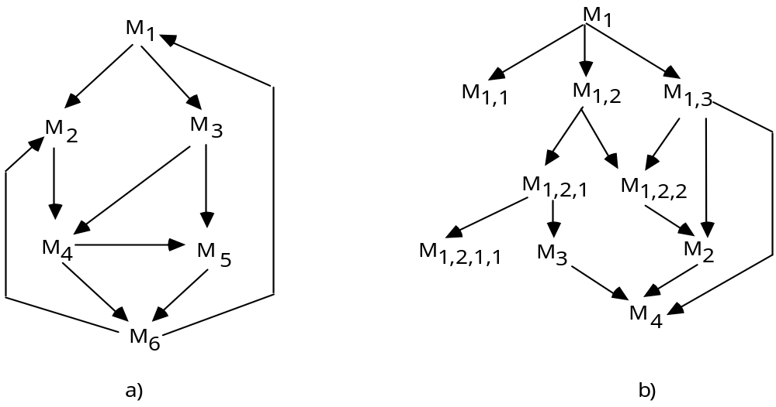
General Graph and DAG
General Graph
Directed Acyclic Graph (DAG)
Figure 5.1 Graph representation of a relation among modules,
(a) General graph, (b) Direct acyclic graph (DAG)
Notes:
A typical general graph is shown in Figure 5.1 (a), showing a relation among modules. There are circles inside the figure.
An example of Directed Acyclic Graph (DAG) is shown in Figure 5.1 (b).
There is no circles in the graph.
Starting from one root node, the nodes could be divided into different levels.

Slide 25
Levels in a Hierarchy Relation
  LEVEL₀: {M_{i} | ¬ ∃ M_{j} ∈ S → M_{i} r M_{j}}
    “___There exists no module M_j at a lower level, which M_i relates to____”
  LEVEL_{k+1}: {M_{i} | ∃M_{j} ∈ LEVEL_{k} → M_{i} r M_{j} and ∀M_{m} ∈ S, M_{i} r M_{m} ⇒ M_{m} ∈ LEVEL_{m}, m ∈ [0,…,k] }
    “__The maximum lexel of module M_j that M_i relates to is level k_”
  module M_{i} is “higher level” than module M_{j} iff M_{i} ∈ LEVEL_{i} and M_{j} ∈ LEVEL_{j} and i > j
Notes:
We define the level of a module in a hierarchy r as follows:
The level of a module M_{i} is 0 if there is no module M_{j} such that M_{i} r M_{j}, and
For each module M_{i}, let k be the maximum level of all nodes. M_{j} such that M_{i} r M_{j}. Then the level of M_{i} is k+1
module M_{i} is “higher level” than module M_{j} if and only if the level of M_{i} is larger than level of M_{j}

Slide 26

General Graph and DAG
General Graph
Directed Acyclic Graph (DAG)
Level
_4_
1=>2=>3=>4
1=>2=>3
0
3
_3_
1=>2
_2_
2
0
1
_1_
1
0
_0_
Figure 5.1 Graph representation of a relation among modules,
(a) General graph, (b) Direct acyclic graph (DAG)
Notes:
A typical general graph is shown in Figure 5.1 (a), showing a relation among modules. There are circles inside the figure.
An example of Directed Acyclic Graph (DAG) is shown in Figure 5.1 (b).
There is no circles in the graph.
Starting from one root node, the nodes could be divided into different levels.

Slide 27
The USES Relation
  For two distinct modules M_{i}, M_{j} ∈ S, M_{i} USES M_{j} iff correct execution of M_{j} is necessary for M_{i} to be correct
    M_{i} is a client of M_{j}
    An obvious USES example is when M_{i} and its correctness depend on a call to a procedure in module M_{j}
  Q: Is __procedure calls__ equivalent to ____USES______ relation?
Notes:
For any two distinct modules M_{i} and M_{j}, we say that M_{i} USES M_{j} if M_{i} requires the presence of M_{j}, because M_{j} provides the resources that M_{i} needs to accomplish its task.
If M_{i} USES M_{j} we also say that M_{i} is a client of M_{j}
An obvious USES example is when M_{i} and its correctness depend on a call to a procedure in module M_{j}

Slide 28

USES Is Not Equivalent to Calls
  procedure calls are not the only way for modules to interact (Not all USES are calls)
    E.g.1 in assembly, a module may modify local data or instructions of another module
    E.g.2 __sharing common data areas___
write
read
C: _______static______
Fortran: ___common block____
General: __Global__Variables
Q: Which module USES which module?
A: M2 USES M1
Notes:
Procedure calls are not the only way for modules to interact. Here are some examples:
An unstructured type of use occurs when a module modifies data—or even instructions—that are local to another module. This may happen in the case of assembly-language programs.
A module may use another module by communicating with it through a common data area, like a C static variable or a FORTRAN COMMON block.

Slide 29
USES Is Not Equivalent to Calls
  E.g.3 exchange of control information (_flags_)
  E.g.4 in sequential environment, modules may communicate via parameter passing through subprograms
  E.g.5 in concurrent environment, modules may communicate via messages passing through tasks
  Not all calls are USES
    E.g. calling for reporting exceptions
Notes:
Procedure calls are not the only way for modules to interact. Here are some examples:
The data exchanged between two modules may he “pure” data, or they can be control information, such as flags. Exchanging control information often results in a tricky kind of interaction that impairs the readability of programs.
A subprogram may communicate with another by invoking it with suitable parameters. This is a disciplined and traditional way of how two functional modules interact.
In a concurrent environment, a client module may communicate with a server through a remote procedure call (or a remote method invocation, as in Java). In a similar fashion, in the Ada programming language, a module M enclosing task T_{M}. may use a module M enclosing task T_{M}. by having a call to an entry of task T_{M} . These are disciplined ways for two concurrent modules to communicate with each other.

Slide 30
USES Relation
USES relation is static, i.e., independent of the execution of the s/w:
in Module M:
“if cond then proc1 else proc2”
in M₁ in M₂
“ “ USES
M
M1
M2
Notes:
USES relation is static, that is, the identification of all paris <Mi,Mj> belongs to USES is independent of the execution of the software.
To clarify this issue, consider a module M that uses modules Ml and M2 by calling one of their procedures. if the client module M contains the code structure
if cond then proc1 else proc2
where proc1 is a procedure of module M1 and proc2 is a procedure of module M2, then M USES M1 and M USES M2, although during any particular execution it may well happen that either M1 or M2, but not both, is invoked.

Slide 31
USES Relation
For a good design, USES relation should be hierarchy
  easy to understand
    “separation of concerns” => used components first, then their clients
  easy to implement
    “incrementality” => otherwise, “we may end up with a system in which nothing works until everything works.”
  easy to define structure
    “levels of abstraction” => high-level modules (clients) first, then low-level (used) modules
(iii) ⇒ ____top-down____ design
(i)(ii) ⇒ ___bottom-up_____ implementation
Notes:
A good restriction to impose on the USES relation is that it should be a hierarchy.
Easier to understand than nonhierarchical ones:
Once the abstractions provided by used components are understood, client components may be understood without looking at the internals of the used modules. In other words, separation of concerns can be applied by traversing the USES structure, starting with the nodes of the DAG that do not use any other nodes, up to the nodes that are not used by any other nodes.
Easy to implement
We have a beneficial practical effect: Quoting Parnas, if the structure is not hierarchical, “we may end up with a system in which nothing works until everything works.”
Easy to define structure
The resulting structure defines a system through levels of abstraction. First the high-level modules and then the low-level ones. A system described by a hierarchical USES relation may be understood in terms of successive levels of abstraction.

Slide 32
How to Build Hierarchy Relations?
Key: decoupling modules to avoid recursion among modules.
recursion within a module does not affect the relation among modules
consider an alternative algorithm which does not require recursion
if two modules have to USES each other recursively, group them together into one large module
Notes:
Then there is a question that how could we build hierarchy relations. The key to do that is avoid recursion among modules. Here are some hints:
Recursion within a module does not affect the relation among modules (the recursion module with other modules).
Consider an alternative algorithm which does not require recursion
If two modules have to USES each other recursively, group them together into one large module

Slide 33
How to Build Hierarchy Relations?
consider splitting one module into two:
M
M₃
M
M₃
M
M₃
M1
M1→M3→M2
M2
Notes:
Then there is a question that how could we build hierarchy relations. The key to do that is avoid recursion among modules. Here are some hints:
Consider two modules depends on each other like the one in the figure. One module M could be split into two sub-modules, one USES M3 and M3 USES another one.

Slide 34
IS_COMPONENT_OF Relation
Let S be a set of modules M₁,M₂,…,M_{n}
  for any M_{i},M_{j} ∈ S, M_{i} IS_COMPONENT_OF M_{j} means
  “M_{j} is realized by several modules, one of which being M_{i}”
  M_{j} COMPRISES M_{i}
  Let M_{s,i} be a subset of S where
  M_{s,i} = { M_{k} | M_{k} ∈ S and M_{k} IS_COMPONENT_OF M_{i}}
  then we say
  M_{i} IS_COMPOSED_OF M_{s,i} or M_{s,i} IMPLEMENTS M_{i}
Notes:
IS_COMPONENT_OF is another relation among modules that is useful for describing designs. This relation allows designers to describe an architecture in terms of a module that is composed of other modules that may themselves be composed of other modules, and so on.
Let S be a set of modules. For any Mi and Mj. in S, Mi IS_COMPONENT__OF Mj means that Mj is realized by aggregating several modules, one of them being Mi. It is also possible to define COMPRISES as the inverse relation of IS_COMPONENT_OF.
Let M_{s,i} be a subset of S defined as follows:
M_{s,i} = { M_{k} | M_{k} ∈ S and M_{k} IS_COMPONENT_OF M_{i}}
Then we can say that Mi IS_COMPOSED_OF M_{s,i} and conversely M_{s,i} implements M_{i}

Slide 35
M
M
M
M
M
M
7
8
9
5
6
1
Figure 5.2 An example of the IS_COMPONENT_OF relation
M
M
3
M
4
2
M
M
M
4
2
3
M
M
M
M
M
M
1
7
8
9
5
6
(IS_COMPONENT_OF)
(COMPRISES)
M7 is component of _M2_
__M2__ comprises M7
__{M7, M8, M9}__ implements M2
M2 is composed of ___ {M7, M8, M9} ____
Notes:
For example, suppose that the figure describes the modular structure of an application in which M₂ is the module providing input facilities, M₃ is the heart of the system, providing all the processing, and M₄ provides output facilities. In turn module M₂ is composed of various modules (M_{7,} M₈ and M₉), each providing certain input services, such as input through digitalization of input forms, input through I/O terminals etc. Module M₃ is decomposed into M₅ and M₆. The final system contains only physical modules that correspond to the elements of the IS_COMPOSED_OF relation that are not further decomposed into other modules—in the-example,M₄, M₅, M₆, M₂, M₈, and M₉.
It is possible to complete the graph of the figure with a directed arc from node M₆ to, say, node M₄, to indicate that M₆ is a component of both M₃ and M₄. When a module M_{i} is a component of both modules M_{j} and M_{k}, one can give an obvious alternative description according to which M_{i} is a component of just M_{j}. and use a copy of M_{i} as a component of M_{k}.

Slide 36
Notations for a Design
In a design, once M_{i} is decomposed into the set M_{s,i}, it is replaced by them in the implementation; M_{i} becomes merely an abstraction for that implementation
Physically, the final implementation only contains the “leaf” modules in a COMPRISES relation graph
Notes:
The notations for a design:
In a design, once M_{i} is decomposed into the set M_{s,i}, it is replaced by them in the implementation; M_{i} becomes merely an abstraction for that implementation.
Physically, the final implementation only contains the “leaf” modules (e.g., M_{s,i}) in a COMPRISES relation graph

Slide 37
Product Families Revisited
Comprises /
Is-composed-of
Uses
M3
M1
M3,1
M3,2
M3,3
Design Decision 1
M2
M3
M4
Version 1
M5
M7
M6
Uses
Version 2
M1
Design Decision 2
Uses
M1
M2
M4
_M3,1_
M2
M4
_M3,3_
__M5__
__M6__
__M5__
__M7__
Notes:
Suppose you turn to the design of any of such modules, say, M₃. At this point, you may realize that any design decision you take will separate one subset of family members from others; for example, M₃ is an output module, and its design may need to discriminate between textual output and graphical output, to be dealt with by two different family members. Suppose you make the decision to follow one of the design options (in the example, the graphical output) which leads you to decompose M₃ into M_{3,1},M_{3,2}, . . . ,M_{3,i3}, with some USES relation defined on this set.
You should record these design decisions carefully, so that future changes will be made reliably. You should never allow yourself to modify the final implementation by changing the code in order to meet the new requirements.
Rather, the recorded documentation of the structure of the modules should force you to resume the design from the decomposition of module M₃, so that you may provide different implementation in terms of lower level components. Note, however, that the rest of the system will remain untouched; that is, modules M₁, M₂ and M₄, . . . , M_{i}, will not be affected by the design of the new family member.

Slide 38
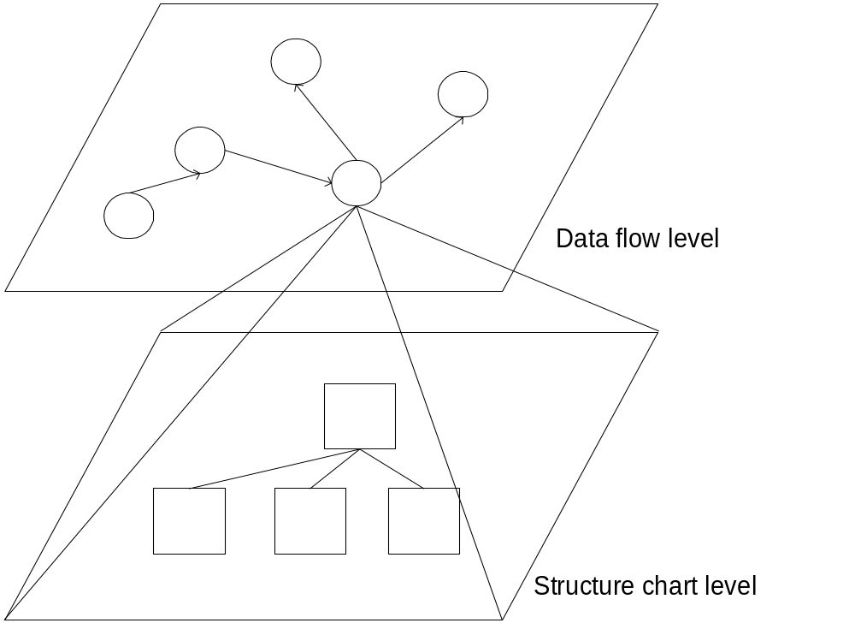
Design Level Visibility
(e.g., DFD)
Q: What is the relation here?
A: “IS_COMPOSED_OF”
(for each function)
Notes:
The visibility could be divided into levels in design
The figure shows an example of two levels, one data flow level and a structure chart level
The data flow level shows the data flow of the system
The structure chart level shows the details of how a module in data flow level is organized

Slide 39
A Good Design Hierarchy
Partition the design: horizontal vs vertical
there is more than one level
there aren’t too many levels
for each M_{i} ∈ S, the set of modules
  {M_{j} | M_{i} r M_{j} } to which it USES is small
  “low _fan-out__” – number of outgoing edges of a module
  ( example )
Notes:
There are several principles of good design hierarchy
Partition the design either horizontal or vertical
There should be more than one level, otherwise everything mass up
But there should not be too many levels, otherwise the design is too complicated.
Make the set of modules one module M_{i} USES small. Which means low fan-out of a module

Slide 40
A Good Design Hierarchy
for each M_{i} ∈ S, the set of modules (clients)
  {M_{j} | M_{j} r M_{i}} which USES M_{i} is large
  “high _fan-in_” – number of incoming edges of a module
___high__ cohesion
  internal connections in a module
____low___ coupling
  external connections among modules
Notes:
There are several principles of good design hierarchy
Make the set of modules USES one module M_{i} large. Which means high fan-in of a module
High cohesion
More internal connections in a module
Low coupling
Less external connections among modules

Slide 41
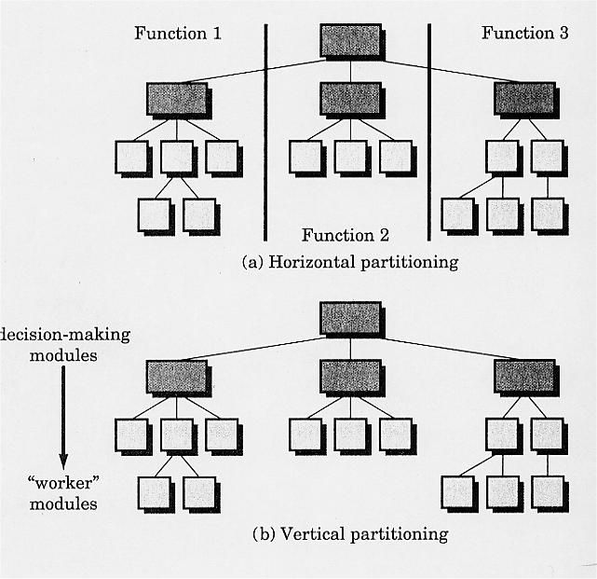
Notes:
The figure shows examples of horizontal partitioning and vertical partitioning
Figure a) shows a horizontal partitioning
The functions 1-3 are divided horizontally. Three functions are parallel which means they could be implemented in parallel.
Figure b) shows a vertical partitioning
The modules are not divided into different functions as in a).
The partitioning is top-down. The top modules are decision making ones and the low level modules are “worker” modules which do the real functionality.

Slide 42
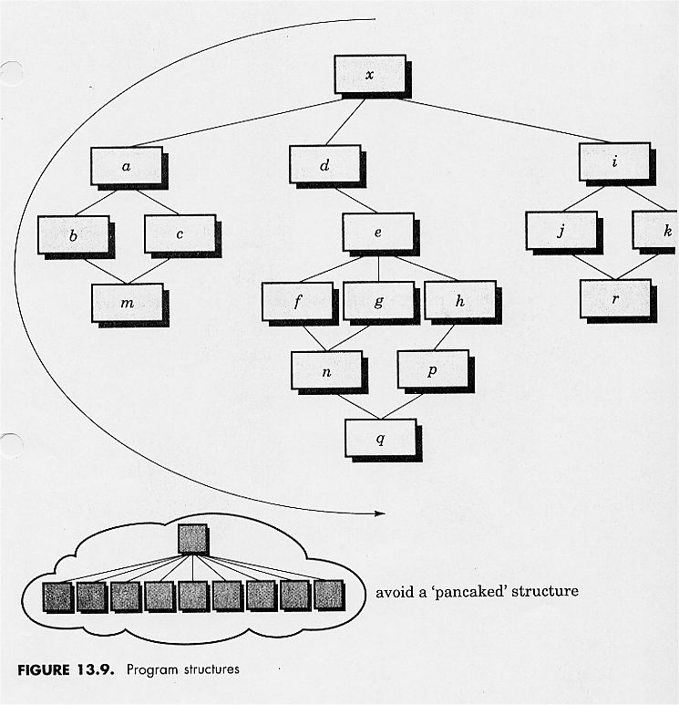
Notes:
The figure shows example of avoiding high fan-out
In both figures the modules are organized as a tree.
In the top figure the largest fan-out is 3 while in bottom figure the largest one is 9.
The top one is better.

Slide 43
Interface, Implementation, and Information Hiding
In the USES relation, the set of services that each module provides to its clients is called ___interface_____
  The services are exported by the used modules and imported by the clients
The interface is an __abstraction__ of the module as viewed by its clients
A designer of module M only needs to know the interfaces of other modules used by M, and may ignore their __implementation___.
Notes:
The set of services that each module provides to its clients (i.e., the purpose of the module as it relates to other modules) is called its interface.
The corresponding services are said to be exported by the module and imported by the clients.
The interface of a module M describes exactly what the client modules need to know in order to utilize the services provided by M. The interface is an abstraction of the module as viewed by its clients.
The designer who is in charge of M, while working on the design, needs to know only the interfaces of the other modules used by M and may ignore their implementation.

Slide 44
Interface, Implementation, and Information Hiding
Interface
  ___variables (parameters)___
  ___functions (procedures)___
  __response time information__
In summary, the clients of a module know about its services only through its interface, the implementation is hidden from them
⇒ Information hiding, an important concept for software engineering principles
Notes:
The interface of a module M may be viewed as a contract between M and its clients; that is, the interface records all and only the facilities the designer in charge of M agrees to provide to other designers.
In most practical cases, interfaces describe computational resources, such as
a variable that belongs to a module and is made accessible to other modules to provide a form of interaction
procedures (functions) that must be called to have some operation performed.
nonfunctional description of the interface (e.g., Information concerning the response time of an exported routine)
The clients of a module, know about its services only through its interface; the implementation is hidden from them. This means that the implementation may change without affecting the modules clients, provided that the interface remains unchanged.
Thus, a crucial aspect of design consists of defining precisely what goes into a module’s interface—and therefore is visible to its potential clients—-and what remains hidden in the implementation and can be changed at any time without affecting the clients

Slide 45
How to Design Interfaces Facilitating Information Hiding?
The interfaces should be as simple as possible, but not simpler
identify changeable design decisions and unchangeable module information
  unchangeable information
    ⇒ ___interfaces__ (stable)
  changeable design decisions
    “secret” (hidden in the _implementation_)
    We say such information is __encapsuled___ within the module implementation.
Notes:
Clearly, the interface of a module should reveal as little information as possible, but sufficient information for other modules to use the services provided by the module. Revealing unnecessary information makes the interface unnecessarily complex and reduces the understandability of the design of the system. Also, by revealing knowledge of internal details that is not necessary, it is more likely that a change to a module will affect not only its implementation, but also its interface.
module interfaces represent stable information (i.e., information that is not affected by the changes).
We say that the changeable, hidden information becomes the secret of the module; also, according to widely used jargon, we say that such information is encapsulated within the module implementation.

Slide 46
Typical Secrets
The algorithm for carrying out some operation, e.g. algorithms for sorting routine
The representation of some data structure, e.g. abstract data type
  Clients know how to operate it, but do not know how it is implemented
The details of an interface to the abstract machine underlying the s/w
The policy for allocating some resource or ordering certain operations (e.g., PRINT a sorted list)
Abstract data type
Q1: What are two standard policies?
A1: eager policy vs lazy policy
Q2: Pros and cons? How to decide?
Q3: Propose a new policy to combine them
Notes:
To maximize the evolvability of a module implementation, its interface should export the minimum possible amount of detail. Another goal is to hide low-level details and provide an abstract interface in order to make the design more understandable.
The algorithm for some operations
The representation of some data structure.
We may choose to use a linear array, a hash table, a linked list, a binary tree, or even other, more sophisticated data structures. The important goal we wish to reach is the ability to change the data structure without affecting client modules.
Details of an interface to the abstract machine underlying.
This includes details of some operating system calls, as well as intricacies of the required interactions with some special peripheral devices. The main reason for hiding these details is to protect the application against changes in the underlying abstract machine.
Policy for allocating some resource or ordering certain operations.
Abstract data type

Slide 47
Abstract Data Type
Abstract data type is an information hiding module where the representations of data structures are encapsulated.
  e.g. A “stack” could be defined in only four operations in its interface: _push__,__pop__,__top__, init
Notes:
Abstract data type is an information hiding module where the representations of data structures are encapsulated.
For example, a “stack” could be defined in only four operations in its interface: push, pop, top, init

Slide 48
A Note About Architectural Design
A precise definition of the interface is necessary for module (re)usability
  High __fan-in__; High __cohesion__
The interface must contain all the information that is needed to characterize the module’s behavior, and nothing more
  Low __coupling_
Notes:
First, a clear distinction between the interface and the implementation and a precise definition of the interface are necessary for module (re)usability. A module may be (re)used in any context, provided that the services listed in its interface match the clients’ expectations, no matter what the implementation is.
Second, the interface must contain all the information that is needed to characterize the module’s behavior as viewed by the clients. As we pointed out, in most cases interfaces provide descriptions of routines to be invoked by client modules. They can also provide a description of shared data. Furthermore, in real-time applications, the response time of an exported operation is part of the interface.

Slide 49
Procedures for Architectural Design
Apply USES and IS_COMPONENT_OF Notations
Build hierarchy relations (avoid recursion)
Identify modules with high cohesion and low coupling
Design interface
Hide information
Reduce design complexity => exercise
Notes:
Summing up all the discussion previously. The procedure for architectural design could be as follow:
Apply USES and IS_COMPONENT_OF Notations
Build hierarchy relations (notice one should avoid recursion to build a DAG)
Identify modules with high cohesion and low coupling
Design the interface
Hide information with abstractions, interfaces, etc.
Reduce design complexity

Slide 50
(2) Detailed Design
s/w design notations
  formal in syntax
  informal in semantics
  TDN (Textual Design Notation)
  GDN (Graphical Design Notation)
Notes:
The notation is formal as far as the syntax of interfaces is concerned. For example, it says, in a syntactically correct form, how to formulate a request for a service exported by a module.
But it does not formally specify the semantics of the exported services (i.e., what a service actually accomplishes for the clients, along with possible constraints‘ or properties that clients need to know).
The semantics is described only informally, by means of comments. (TDN and GDN)

Slide 51
TDN: Textual Design Notation
key sections (_clauses__)
  module
  uses
  exports
    var, type, procedure (resources)
  implementation
    list internal components
  end
__name____
__USES___ relation
__interface_
IS_COMPOSED_OF relation
Examples (Figure 5.3, Figure 5.4, Figure 5.5)
Notes:
We assume that a module may export any type of resource: a variable, a type, a procedure, a function, or any other entity defined by the language.
In general, if a module requires a special protocol to be followed to request one of the module’s exported services, then-this requirement should be stated as a comment associated with the syntactic description of the exported service in the module interface.
The parts of the module’s description discussed so far define the interface—that is, what is visible to client modules. TDN, in addition, supports the description of other aspects of the architecture that may be necessary for its proper documentation.
A uses part specifies the names of used modules (if any), and an implementation part gives a high-level description of the implementation, which may be useful for understanding the module’s rationale.
the implementation part gives the list of internal components, according to IS_COMPOSED_OF. Using informal comments, we may also describe which secrets are encapsulated within the module and why.

Slide 52
Figure 5.3 A Sample Module Description
module X
uses Y, Z
export
var A: integer;
type B: array (1..10) of real;
procedure C(D: in out B; E in integer; F: in real)
Implementation
is composed of R, T
end X
Notes:
module X
uses Y, Z
exports var A: integer;
type B; array (1..10) of real;
procedure C (D: in out B; E: in integer; F: in real);
Here is an optional natural—language description of what
A, B, and C actually are, along with possible constraints
or properties that clients need to know; for example, we
might specify that objects of type B sent to procedure C
should be initialized by the client and should never
contain all zeroes.
implementation
If needed, here are genera} comments about the rationale
of the modularization, hints on the implementation, etc.
is composed of R, T
end X

Slide 53
Figure 5.3 A Sample Module Description
module X
uses Y, Z
export
var A: integer;
type B: array (1..10) of real;
procedure C(D: in out B; E in integer; F: in real)
Here is an optional natural language description of what A, B and C actually are, along with possible constraints or properties that clients need to know; for example we might specify that objects of type B sent to procedure C should be initialized by the client, and should never contain all zeros.
Implementation
If needed, here are general comments about the rationale of the modularization, hints on the implementation, etc.
is composed of R, T
end X
Notes:
module X
uses Y, Z
exports var A: integer;
type B; array (1..10) of real;
procedure C (D: in out B; E: in integer; F: in real);
Here is an optional natural—language description of what
A, B, and C actually are, along with possible constraints
or properties that clients need to know; for example, we
might specify that objects of type B sent to procedure C
should be initialized by the client and should never
contain all zeroes.
implementation
If needed, here are genera} comments about the rationale
of the modularization, hints on the implementation, etc.
is composed of R, T
end X

Slide 54
Figure 5.4 Sample Components of Module X
module R
uses Y
export
var K: record … end;
type B: array (1..10) of real;
procedure C(D: in out B; E in integer; F: in real)
Implementation
…
end R
module T
uses Y, Z, R
exports var A: integer;
implementation
…
end T
Notes:
What characterizes a module from its client’s viewpoint (i.e., the module’s interface) is exactly what appears in the exports section. The rest of the description does not deal with the interface, but serves to document the architecture in a precise manner. Thus, a change in the exports clause will affect the functional correctness of the clients, whereas changes to other sections will not.
In the example, modules R and T eventually must be defined; if they aren’t, we have a manifest case of incompleteness. Since R and T actually replace X, one or both must use one of”; or Z, or both. (Otherwise the uses clause of X would be wrong.) In addition to importing from Y and Z, R and T may import from one another. Also, what X exports should be a subset of the union of the sets of resources exported by R and T.5 All of these constraints should be checked to assess the consistency and completeness of the description.
The uses clause in a module specification describes exactly the USES relation. The clause simply states that a module may access any resource exported by another module. It may be useful to refine the uses clause by stating exactly which resources are imported by the module. Should this be required, we will use the notation

Slide 55
Figure 5.5 An Example of a Module with Selective Import
module W
uses X imports(B,C),
XX
exports …
implementation
.
.
.
end W
X exports _A,B,C___;
only __B,C__ are imported here;
referred as __X.B, X.C__.
XX resources _all imported__.
Notes:
If no imports clause is provided, all exported resources may be imported by the module. An example of a module W that uses modules X and XX is given. The example shows that W imports specific resources from X (selective import), whereas it imports all of the resources exported by XX.

Slide 56
TDN
A TDN design takes some time to comprehend
TDN can provide various levels of details
  e.g., ___pseudo code___ in great detail
The designer needs to check for consistency and completeness
The tedious checking procedure should be automated if possible
A more complicated example follows
Notes:
The benefit of using a design notation like TDN instead of an unstructured and colloquial description lies in the rigor and precision of such a notation.
In the fact that the design description can be checked for consistency and completeness.
The check can be done manually, by carefully examining the textual description, or mechanically if we provide a specific tool to perform it. The way it can be done is explained next.
A more complicated example about compilation process of a compiler follows.

Slide 57
Compiler Design: Modularity
Compilation process decomposed into phases
  Lexical analysis
  Syntax analysis (parsing)
  Code generation
Phases can be associated with modules
Notes:
This slide gives an overview of a compiler design, using the software engineering principle of “Modularity”.
A compilation process is usually decomposed into three phases: lexical analysis, syntax analysis (parsing), and code generation.
Each of the above phases can be associated with modules.
5-<number>

Slide 58
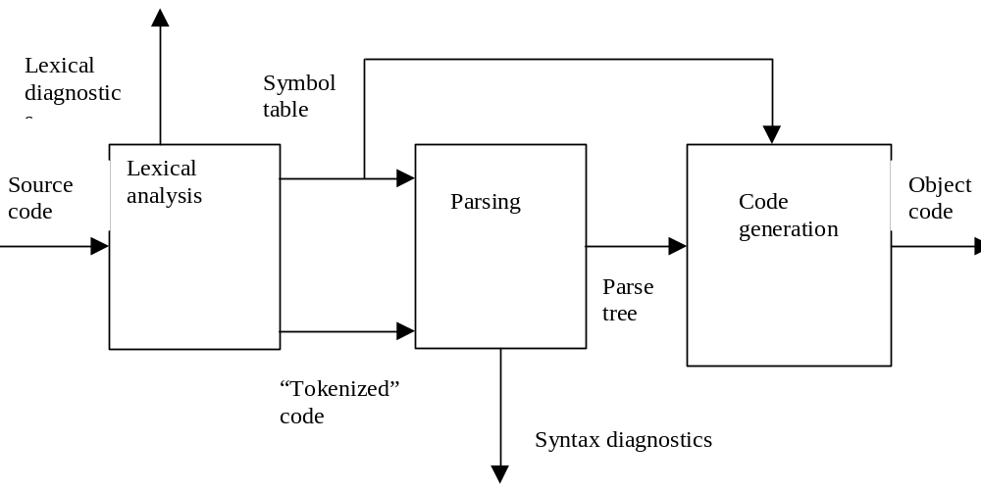
Representation of Modular Structure
boxes represent modules
directed lines represent interfaces (i.e., inputs and outputs)
Notes:
The compiler is designed to go through three phases, correspondingly three modules: Lexical analysis module, Parsing module, and Code generation module.
The interfaces of the three modules are also identified.
5-<number>

Slide 59
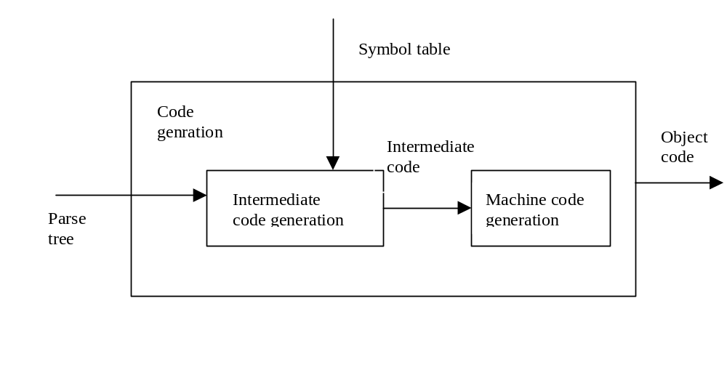
Module Decomposition May Be Iterated
Further modularization of code-generation module
Notes:
Further module decomposition can be conducted in the software design through iterations.
This slide shows the detailed design of Code generation module, where two submodules are identified: Intermediate code generation module, and Machine code generation module.
The corresponding interfaces are also identified.
5-<number>

Slide 60
Example: A “MINI” Compiler
module COMPILER
exports procedure MINI ( PROG: in file of char;
CODE: out file of char);
MINI is called to compile the program stored in
PROG and produce the object code in file CODE
implementation
A conventional compiler implementation
ANALYZER performs both lexical and syntactic analysis and produces an abstract tree as well as entries in the symbol table:
CODE_GENERATOR generates code starting from the abstract tree and information stored in the symbol table. Module MAIN acts as a job coordinator.
is composed of ANALYZER, SYMBOL_TABLE,
ABSTRACT_TREE_HANDLER,
CODE_GENERATOR, MAIN
end COMPILER
Notes:
Here we address the problem of designing a compiler for MINI. One possible architecture is shown in this example.
Suppose we are designing an interpreter for a very simple programming language, MINI, operating on integers and integer arrays. We provide a symbol-table module that is used to store information about the variables of a program. The symbol table exports a procedure GET that accepts as input the symbolic name of a variable and, possibly, the value of an index (in the case of an array) and returns the value of the variable. Similarly, a procedure PUT makes it possible to store a new value for a given variable. When a new variable declaration is encountered, a new entry is created in the symbol table by calling a procedure CREATE, passing it the name of the variable and its size (the number of integer entries it represents).
The purpose of the interface we are designing is to hide the physical structure of the table from the clients of the symbol-table module. To warn clients when they either try to read or write the value of a variable that does not exist or try to access an array with an invalid index value, the procedures GET‘ and PUT return an additional parameter, POS. The value returned for POS is a pointer to the variable stored in the table if such variable exists, or it is the null pointer if the variable does not exist.

Slide 61
Example: A “MINI” Compiler
module MAIN
uses ANALYZER, CODE_GENERATOR
exports procedure MINI(PROG: in file of char;
CODE: out file of char);
.
.
end MAIN
module ANALYZER
uses SYMBOL_TABLE, ABSTRACT_TREE_HANDLER
exports procedure ANALYZE(source :in file of char);
SOURCE is analyzed; an abstract tree is produced by
using the services provided by the handler, and recognized
entities, with their attributes are stored in the symbol table.
end ANALYZER
Notes:
This design can be criticized because of the redundancy in the interface. If our purpose is just to provide operations to store and retrieve data (and signal the case where access to the data is incorrect), then we are providing additional information (i.e., the position in the table where the data are stored). Such redundancy has negative side effects on the ease of changing the design, as we shall show shortly. It also provides a loophole into information hiding.
The secret of the symbol-table module is the data structure chosen for internal representation. We may choose to use a linear array, a hash table, a linked list, a binary tree, or even other, more sophisticated data structures The important goal we wish to reach is the ability to change the data structure without affecting client modules. The reason is that we want to design and implement the system quickly, by first concentrating on the module’s structure, without spending too much time designing and tuning the data structures in each module; We want to postpone the decision about the nature of the internals of each module, such as the “best” type of data structure, to a later point, after we have completed the entire design of the interpreter and, maybe, collected some execution proﬁles.

Slide 62
Example: A “MINI” Compiler
module CODE_GENERATOR
uses SYMBOL_TABLE, ABSTRACT_TREE_HANDLER
exports procedure CODE(OBJECT: out file of char);
The abstract tree is traversed using the operations exported by the ABSTRACT_TREE_HANDLER and accessing the information stored in the symbol table in order to generate code in the output file.
.
.
.
end CODE_GENERATOR
Notes:
If we examine the interface closely, however, we see that it reveals more than is necessary; in particular, it reveals part of its (supposed) secret. By knowing the address of the storage area for a variable (revealed by both GET and PUT), we are allowed to access that variable directly, without being obliged to go through the interface procedures. For example, if a client accesses the same simple variable—-say, X—repeatedly, the client might be tempted to obtain the value of POS and then use the pointer directly to access the variable X. This method would work correctly only if the position at which the value is stored does not change over time. That would be the case in a simple implementation of the symbol table module in which new declarations encountered are merely appended at the end of a sequential data structure.
Even if the software might work in this case, which may correspond to the initial release of the system, it would become incorrect in a future release of the symbol table that replaces the sequential data structure by one that keeps its entries sorted. In fact, as new declarations were encountered, they would have to be recorded in the appropriate position in the data structure, and this might imply shifting some existing entries, invalidating the values previously returned by POS.

Slide 63
GDN (Graphical Design Notation)
a box represents a __module____
incoming arrows represent a module’s _access path_, i.e., exported _resources_
not to be confused with DFD
can also show “IS_COMPOSED_OF” and “IS_COMPONENT_OF” relations
Notes:
A picture is worth it thousand words, according to folk wisdom. In this part, we provide a graphical design notation (GDN) that reﬂects the TDN textual description.
A module is represented by a box whose incoming arrows represent its interface (i.e., the exported resources). The reason exported resources are represented by incoming arrows is motivated by the fact that exported resources are accessible from the outside; that is, they represent an access path into the module.
If a module M is a component of both modules L and N, we draw a box labeled M in both L and N. Should M be composed of other modules, the IS__COMPONENT__OF structure for M is described separately.

Slide 64
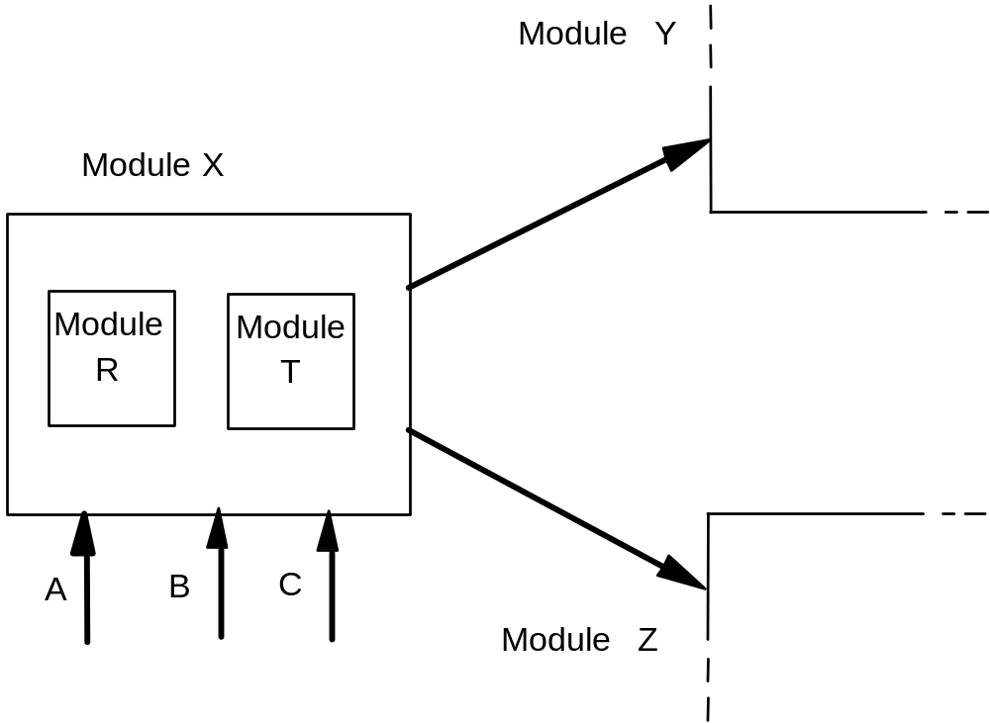
Figure 5.6 GDN of Module X
Figure 5.6 Graphical description of module X of Figure 5.3
Notes:
Figure 5.6 gives a graphical description of the module X. The fact that X uses modules Y and Z is shown by bold directed edges connecting X to Y and Z. Details of the exported resources—such as the number of procedure parameters, their type, and the type of variables—are omitted for simplicity, but may be added as annotations on the incoming arrows.

Slide 65
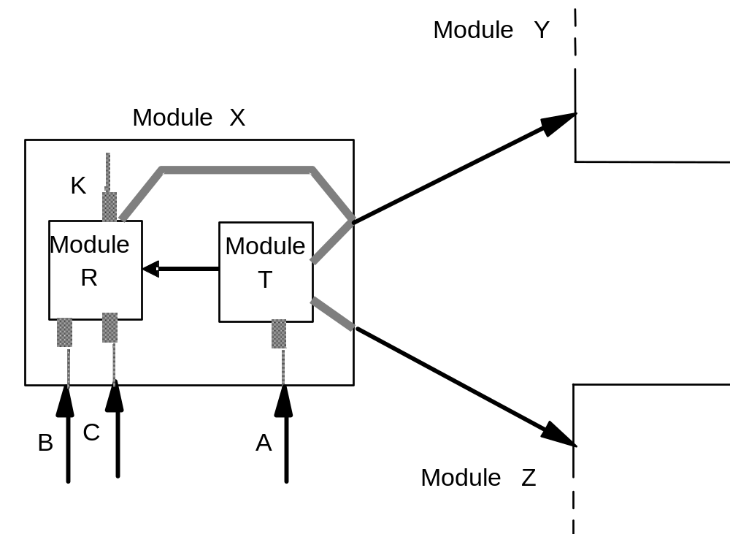
Figure 5.7 X’s Decomposition
Figure 5.7 Module X is composed of modules R and T
Notes:
A box is empty if the module is elementary—that is, if it is not composed of any subcomponents. This is not the case with module X, which is composed of R and T. Since modules R and T are components of X, we can expand their definition inside X; the resulting description is shown in Figure 5.7.
Figure 5.7 shows explicitly which inner modules actually originate the resources exported by module X: B and C are provided by R, and A is provided by T. Graphically, this relationship is depicted by using shadow lines to connect export arrows of module X with the corresponding export arrows of modules‘ R and T. Similarly, boldface shadow lines are used to specify which of R and T actually uses the modules used by X.

Slide 66
Module L
Module N
Module M
IS_COMPONENT_OF what?
___L,N____
IS_COMPOSED_OF what?
___{H,G}_________
Exports what?
___A,B_______
USES what?
__F__ (which exports __K__ )
Module M
Module M
Module R
Module S
A
Module M
Module F
Module H
Module G
K
B
Figure 5.8 Module M is a member of both L and N
Notes:
If a module M is a component of both modules L and N, we draw a box labeled M in both L and N. Should M be composed of other modules, the IS__COMPONENT__OF structure for M is described separately. This is sketched in Figure 5.8 in the case where M exports A and B and is composed of G and H.

Slide 67
GDN (Graphical Design Notation)
It provides “s/w design visualization”
It is useful in comprehending complicated s/w (e.g., concurrent s/w)
It may take too much space
It is useful for high-level view of the s/w design
Detailed levels need to be automated (CASE)
  Many are UML based:
  https://en.wikipedia.org/wiki/List_of_Unified_Modeling_Language_tools
Notes:
The reason engineers customarily adopt pictorial notations for their blueprints is that graphical descriptions can be more intuitive and easier to grasp than textual descriptions.
GDN provides software design visualization
GDN is useful in comprehending complicated software (e.g., concurrent software).
But GDN may take much space as the graph may become very big for large system.
GDN is useful for high-level view of software design
The details levels of the graph design need to be automated by some tools (e.g., Statemate, Rational, UML)
TDN and GDN complement each other. They can be both used in the design.

Slide 68
Categories of Modules
Procedural abstractions
  purpose: to encapsulate an __algorithm__
  e.g.: sorting module, fast Fourier transform module
Libraries
  purpose: to group together related ___________________________
  e.g.:
    mathematical routines
    graphical routines
Notes:
Procedural abstractions can include compilers as another example
Libraries can include “integrals, filters” in Flight Control Computers project as another example
A commonly used type of module provides just a procedure or a function that implements some abstract operation. In other words, such modules provide a procedural abstraction and are used to encapsulate an algorithm. Typical examples are sorting modules, fast Fourier transform modules, and modules performing translation from one language into another.
A module may also contain a group of related procedural abstractions. A typical and successful example is represented by libraries of mathematical routines. Such libraries provide solutions to the most commonly encountered mathematical problems.

Slide 69
Categories of Modules
Common pool of data
  purpose: to share _data_ among several modules
  e.g.: system configuration constants group
  note:
  Q: What is the disadvantages of this kind of modules?
  A 1) high coupling
  2) reduce information hiding
Notes:
Another common type of module provides a common pool of data. Once the need for sharing data among several modules is recognized. We can group such data together in a common pool that is imported by all client modules, which are then allowed a manipulate the data directly, according to the structure used to represent the data, which is visible to them.
An interesting use of a common data pool module is one that groups system configuration constants.
In general, however, a common pool of data is a rather low-level type of module. Such a module does not provide any form of abstraction. Any details of data are visible and manipulable by all clients. The ability to group shared data in a common bloc only provides limited help in terms of readability and modifiability.

Slide 70
Categories of Modules
Abstract objects
  purpose: to hide the details of _data representation_ (change of data structures is ___17%__ of cost for total software maintenance)
  e.g.: a symbol-table
  note: exhibit a state
Notes:
We have already mentioned that nearly 17 percent of the costs involved in software maintenance are due to changes in the representation of data. Thus, a very important type of encapsulation is one that hides the details of data representations and shields clients from changes in them.
A symbol-table module illustrates a typical module that hides a data structure as a secret and exports routines that may be used as operations to access the hidden data structure and modify the values stored in it. Should the data structure change, all we need to change are the algorithms that implement the access routines, but client modules do not need to be changed, since they continue to use the same calls to perform the required accesses.
The hidden data structure provides these modules with a state.

Slide 71
Categories of Modules
Abstract data type
  purpose: to hide the representation of a __data type_ and the algorithms used in _operating_ the objects of that type
  e.g.:
    Stack
    Ada - private type
    Module-2 - opaque type
  note:
  i) no state
  ii) can generate many instances (_abstact object_)
Notes:
An abstract data-type module is a module that exports a type, along with the operations needed to access and manipulate objects of that type.
It hides the representation of the type and algorithms used in the operations.
Such a module can be implemented directly in Ada by exporting a (limited) private type, in Modula-2 by exporting an opaque type, and in Java and C++ by a class.
Instances of an abstract data type are abstract objects that behave exactly like those discussed before. In particular, they can be manipulated only by the routines implemented and exported by the abstract data-type module.

Slide 72
Stack as an Abstract Data Type
Module STACK_HANDLER
exports
type STACK : ?;
This is an abstract data type module; the data structure
Is a secret hidden in the implementation part.
procedure PUSH(S: in out STACK; VAL: in element);
procedure POP(S: in out STACK; VAL: out element);
function EMPTY(S: in STACK): BOOLEAN;
function TOP(S: in STACK): element;
procedure INIT(S: out STACK);
end STACK_HANDLER
A new symbol to export a __type definition__,
leaving implementation detail hidden.
Notes:
We need a way to:
Associate a set of procedures with the type, in order to manipulate instances of that type
Encapsulate the details of the type in the module
This is an example of this kind of module, using texture design notation.

Slide 73
Stack Implemented as an Array
stack: record sp: integer; arr: array[1..Max] of element end;
procedure Push(e:element) is
begin
stack.sp := stack.sp + 1;
stack.arr[stack.sp] := e;
end;
procedure Pop is
begin
stack.sp := stack.sp -1;
end;
function Top return element is
begin
return stack.arr[stack.sp];
end;
procedure Init is
begin
stack.sp := 0;
end;
Notes:
The previous module of stack illustrated by texture design notation could be implemented.
Here is an example of implement the stack module as an array.

Slide 74
Stack Implemented as a List
type stackptr;
type stackelement is record elem: element; next: stackptr; end record;
type stackptr is access stackelement;
stack: stackptr;
procedure Push(e:element) is
item: stackptr;
begin
item := new stackelement;
item := e;
item.next := stack;
stack := item;
end;
procedure Pop is
begin
stack := stack.next;
end;
function Top return element is
begin
return stack.item;
end;
procedure Init is
begin
stack := null;
end;
Notes:
The previous module of stack illustrated by texture design notation could be implemented.
Here is an example of implement the stack module as a list.

Slide 75
Yet Another Example of Abstract Data Type
module FIFO_CARS
uses CARS
exports
type QUEUE :?;
procedure ENQUEUE(Q: in out QUEUE; C: in CARS);
procedure DEQUEUE(Q: in out QUEUE; C: out CARS);
function IS_EMPTY(Q: in QUEUE) :BOOLEAN;
function LENGTH(Q: in QUEUE): NATURAL;
procedure MERGE(Q1, Q2: in QUEUE; Q: out QUEUE);
end FIFO_CARS
Declaration of the type QUEUE:
gasoline_1, gasoline_2, gasoline_3 : QUEUE;
car_wash :QUEUE;
Operations on the type QUEUE:
ENQUEUE(car_wash, that_car);
MERGE(gasoline_1, gasoline_2, gasoline_3);
Notes:
Suppose we are designing a simulation system for a gasoline station. The purpose of the system is to find the “optimal size” (in terms of number of service lines, length of lines, etc.) of the station, given the expected arrival rates of cars, together with their requests for service. Each request for a service is characterized by a certain duration.
We represent each service line (gasoline, cart wash, etc.) by an abstract object that represents the cars waiting for their turn to be served. There will be an operation to place a car in a service line, another to extract a car from the line, another to check whether the line is empty, and another to merge two lines associated with the same kind of resource, should the resource provided by one of them be exhausted. The policy is strictly first in, first out for all service lines.
We introduce an abstract data type module FIFO_CARS that describes FIFO queues of cars. We also assume that cars are described by another abstract data type module CARS, exporting type CAR, used by FIFO_CARS to perform operations on the cars extracted from the queues. The following is a sketch of module FIFO_CARS.

Slide 76
Generic Modules
A generic module is a module that is parameterized with respect to a __type___
  generic module GENERIC_STACK_2 (T)
  uses …
  exports procedure PUSH(VAL: in T);
  procedure POP_2(VAL1, VAL2: out T);
  .
  .
  .
  end GENERIC_STACK_2
It is a module template. To instantiate:
  module INTEGER_STACK_2 is GENERIC_STACK_2 (_integer)
Notes:
A generic module is a module that is parameterized with respect to a type.
In order to be used, it must first be instantiated by providing actual parameters. For example, to instantiate a stack module for integers, we write module INTEGER_STACK_2 is GENERIC_STACK_2 (INTEGER)

Slide 77
Generic Modules
A particular operation for the parameter type should be specified:
  generic module M(T) with OP(T)
  uses …
  .
  .
  end M
  Instantiation:
  module M_A_TYPE is M(A_TYPE) PROC (A_TYPE)
Advantages: Reusability, Generality
Notes:
If the generic module requires its parameter type to support a particular operation, this must be specified in the module header.
At instantiation time, an actual procedure must be passed as a parameter along with the type, as in the declaration: module M_A_TYPE is M(A_TYPE) PROC (M_A_TYPE)
Intrinsically, a generic module is a reusable component, because it factors several. Modules into a unique algorithmic abstraction that is easily reused in different contexts by simple instantiation.
The use of generic modules can be viewed as an application of the principle of generality: Instead of solving a specific problem for, say, integers, we solve a more general problem for a class of types. Special-case solutions can then be derived from the general solution. Viewed in this way, generic modules can be useful for developing families of programs.

Slide 78
More Techniques for Design for Change
Configuration constants
  Constants which might be changed due to different configuration
  E.g., a :array(1..N) of integer;
  N = 100;
  these configuration constants could be grouped into a module that provides
  ___common pool of data____
Notes:
In cases where the required changes in software can be factored out into a set of constants (called configuration constants), the problem may be solved by changing the values of those constants and then recompiling the program.
As we mentioned before, conﬁguration constants may be grouped together in a module that provides a common pool of data. This module would then be used by all clients that need to access the configuration data.

Slide 79
More Techniques for Design for Change
Conditional compilation
  All versions of a program family are represented by one single source copy, and the differences between various versions are determined by condition compilation
  … {portion common to all versions}
  #ifdef h/w-1 {compiled portion if h/w–1 is true}
  #endif
  #ifdef h/w-2 {compiled portion if h/w–2 is true}
  #endif
Software Generator
  yacc - compiler generator
  user interface generator
  executable specification language
Notes:
Configuration constants support only simple ways of representing multiple-version software. More ﬂexible and general schemes may be provided by means of conditional compilation.
With this approach all versions of a family are represented by one single source copy, and the differences between various versions are taken into account by conditional compilation. Source code that is relevant to only some versions is bracketed by macro commands recognized by the compiler. When the compiler is invoked, some parameters must be specified that describe which version of object code is to be produced; the compiler automatically ignores source statements that are not part of the proper version.
Another appealing strategy is to generate automatically a new solution for each requested change. Generator: have been used successfully in restricted application domains.
A typical example is a compiler generator, such as yacc in the UNIX environment, which can generate (part of) a compiler, given the formal definition of the language to be translated.
Another example is a system for generating user interfaces that can be found in most database management systems on personal computers.
Certain specification languages may be executable. In some cases, the speciﬁcation is translated into an implementation, thus generating the application directly from some abstract description.

Slide 80
Stepwise Refinement
a popular method for describing the logical structure of a given algorithm, implemented by a single module
stepwise refinement is an effective way of describing a solution after it has been partially obtained (software engineering principle: _______________)
Notes:
The most popular approach followed is called design by stepwise reﬁnement. Such a design strategy is easy to describe and understand.
Thus, the design process starts with an overall description of the problem to be solved (the “top” function), recursively applies functional decomposition, and terminates as we reach the point where each subproblem is easy to express in terms of a few lines of code in the chosen programming language.

Slide 81
Example: Derivation of Selection Sort
Step 1
let n be the length of the array a to be sorted;
i := 1 ;
while i < n loop
find the smallest of ai .. .an, and exchange
it with the element at position i;
i := i + 1;
end loop;
Notes:
As an example, we discuss the derivation of the selection sort algorithm by stepwise refinement. This is a small programming example, not a design exercise. However, the example clearly illustrates how stepwise refinement works. Shortly, we shall see another example in which stepwise refinement is applied at the design level. The selection sort algorithm proceeds as follows:
First a rough outline of the algorithm is described. Only key steps are kept in the first trial.

Slide 82
Step 2
let n be the length of the array a to be sorted;
i := 1 ;
while i < n loop
j := n;
while j > i loop
if a(i) > a(j) then
interchange the elements at positions j and i ;
end if;
j := j - 1;
end loop;
i := i + 1;
end loop;
Notes:
Then we try to refine some steps in more detail. For example in this case, we describe the loop in a more elaborative way.

Slide 83
Step 3
let n be the length of the array a to be sorted;
i := 1 ;
while i < n loop
j := n;
while j > i loop
if a(i) > a(j) then
x := a(i);
a(i) := a(j);
a(j) := x;
end if;
j := j - 1;
end loop;
i := i + 1;
end loop;
Notes:
Finally, we could finish the complete implementation.

Slide 84
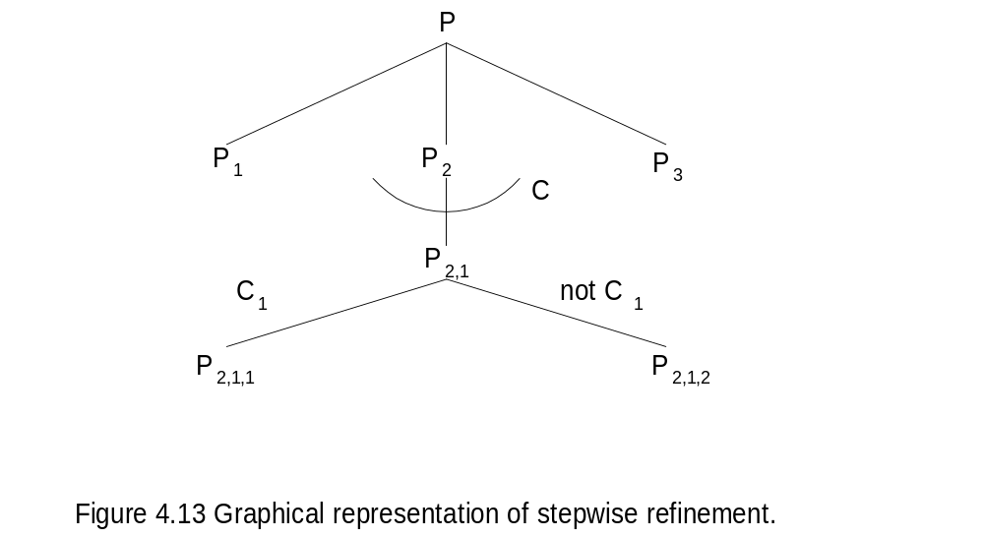
Stepwise Refinement
Step 0
Step 1
[While C loop P_{2,1]}]
Step 2
[ If C₁ then P_{2,1,1}
Else P_{2,1,2}]
Step N
Figure 5.9
Notes:
Graphical representation of stepwise refinement (Legend: solid arc represents iteration; dotted arc represents selection.)
Design by stepwise refinement can be represented graphically by means of a decomposition tree (DT)——a tree in which the root is labeled by-the name of the “top” problem, every other node is labeled by the name of a subproblem, and the child nodes of any given node are labeled by the names of the subproblems that detail it in a refinement. The left-to-right order of child nodes of a given node represents the order in which subproblems are to be solved during program execution. Nodes representing alternative subproblems are identified by a dotted line which groups the arcs that connect the nodes to their parent node; arcs are also labeled by the condition under which the connected subproblerns must be chosen. Iteration is represented by a solid line, to which the condition governing the while structure is added as a label.

Slide 85
Stepwise Refinement
It is a method that works in the small, but fails in the large. Here are the reasons:
  sub-problems tend to be analyzed in isolation, reducing ___reuseability___
  No attention is paid to _information hiding__
  No attention is paid to _______data_______
  The __top___ function may not exist
  A premature commitment to the ____________ structures
Notes:
Stepwise refinement is an effective technique for describing small programs. It fails, however, to scale up to systems of even moderate complexity. Thus, stepwise refinement is a method that works in the small, but fails in the large. Here are a few reasons:
Sub-problems tend to be analyzed in isolation. No emphasis is put by stepwise refinement on trying to generalize sub-problems in a way that would make them reusable at different points within the derivation of the system, let alone across different designs.
No attention is paid to information hiding. Stepwise refinement does not draw the designers attention to the need for encapsulating changeable information within modules.
No attention is paid to data. Stepwise refinement does not stress the use of information-hiding modules.
The top function may not exist. Remember that the top problem should describe the problem as a very high-level function that transforms the input data into the expected results. Such a function, however. does not always exist.
There is a premature commitment to the control structures that govern the ﬂow of control among modules.

Slide 86
A Short Summary About Design
stepwise refinement
  _____top-down______ design
information hiding
  _____bottom-up_____ design
combining both
  ______yo-yo______ design
design should use both schemes
description of the resulting design should be __top-down____
Notes:
Stepwise refinement is an intrinsically top-down method. Some of the criticisms we raised about the method are attributable to its specific characteristics. In particular, the premature commitment to control structures and the orientation to design in the small are due to the programming-language-based style used to describe the refinements.
Information hiding proceeds mainly from the bottom up. It suggests that we should first recognize what we Wish to encapsulate within a module and then provide an abstract interface to deﬁne the module’s boundaries as seen from the clients.
A typical design strategy may proceed partly from the top down and partly from the bottom up, depending‘ on the phase of the design or the nature of the application being designed, in a way that might be called ya-yo design. As an example, we might start decomposing a system from the top down in terms of subsystems and, at some later point, synthesize subsystems in terms of a hierarchy of information-hiding modules.
The design activity should not be constrained to proceed according to a fixed, rigid pattern, but should be a blend of top-down and bottom-up steps.
We recommend that the description of the resulting design be given in a top-down fashion. Such descriptions make it easier to understand the system because they give the big picture first before showing the supporting details.

Slide 87
Handling Anomalies
To achieve reliable solutions
  Systematic design approach
  Rigorous and disciplined implementation
One solution: employ __defensive__ design
  Purpose: build robust systems
  The program should continue to behave reasonably even in the case of unexpected and unforeseen circumstances
Notes:
A systematic design approach followed by a rigorous and disciplined implementation is the best way of dominating the complexity of software development and building reliable products. Unfortunately, no matter how careful we are during development, we cannot trust our software unconditionally.
The designer must anticipate failures and plan to either avoid or tolerate failure. That is, the designer must employ defensive design.
We must build robust systems: Our programs should continue to behave reasonably even in unexpected circumstances.

Slide 88
Handling Anomalies
Anomalous – if a module fails to provide a service as expected and specified in its interface
  _Exceptions_ – to be associated with a service, denoting the anomalies that may occur while that service is being performed
Notes:
We define a module to be anomalous if it fails to provide a service as expected and as specified in its interface.
We do, however, extend our design notations to associate a set of exceptions (defined next) with each service exported by a module. The exceptions associated with a service denote the anomalies that may occur while that service is being performed.

Slide 89
Handling Anomalies
Defensive design requires that upon entering an anomalous state, the module should signal the anomaly by raising an exception to the client
The server module terminates the service after __raise___ an exception; the client responds by suitably _handling_ the exception
Notes:
Defensive design requires that in the latter case the module should signal the anomaly by raising an exception to the client. In other words, we distinguish between the correct behavior and the anomalous behavior of the module.
The server module terminates execution, and the client, notified of the occurrence of the exception, responds by suitably handling the exception.

Slide 90
Why an Exception is Raised by a Module, say M?
M’s client does not satisfy the required protocol for invoking one of M’s service
When providing a service to its client, M does not invoke a service exported by another module properly
M fails to provide its service because of an unforeseen condition
Q: What are examples of the unforeseen or unexpected condition in M
A1: divide by 0
A2: overflow/ array oversize
Notes:
Why should a module M fail to provide its service as specified?
Because M’s client does not satisfy the required protocol for invoking one of M’s services. For example, M’s exported operation op requires a positive parameter, but the client may invoke op with a negative value for the parameter.
Failure also may occur if M does not satisfy the required protocol when trying to use a service exported by another module.
Apart from these types of failures,- a module may fail to provide its service because of an unforeseen condition, such, as an overﬂow or an array index that is out of bounds, occurring during execution of the module.

Slide 91
M’s client
M’s client
A
B;
Handle/ propagate the exception
___
M:
_catch_ an exception
M
B
___
C;
C
throw/raise an exception
___
M’s server
M’s server
Notes:
Failure also may occur if M does not satisfy the required protocol when trying to use a service exported by another module-—say, N. In the latter case, N’s failure is signaled back to M, and M’s exception handler is activated accordingly. The handler may try to recover from the anomaly, or it may simply do some cleanup of the module’s state and then let the routine fail, signaling an exception to its caller.
If the recovery is successful, M does not fail; otherwise, some cleanup may be necessary to ensure that subsequent uses of M by other clients do not find the module in an inconsistent state. Note, however, that exception handlers are hidden (in the module’s body; that is, the exact way an exception is handled by a module is part of the module’s secret.

Slide 92
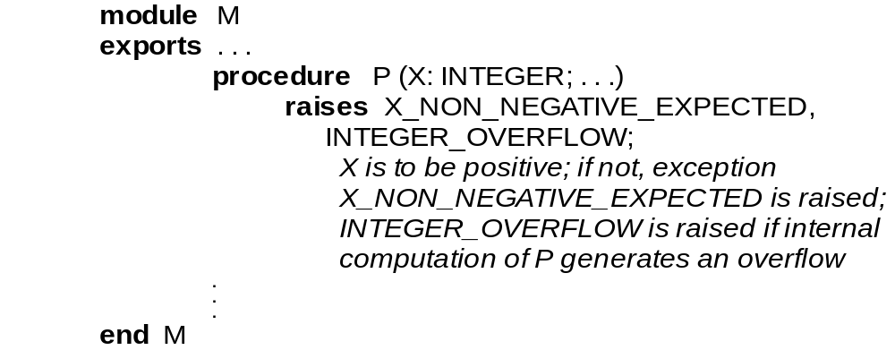
Module M
Notes:
Suppose that when interfaces are defined, designers agree on certain restrictions that apply to parameters of a procedure P enclosed in some module M. For example, they might agree that P should receive a nonnegative value for parameter X. This decision is recorded in M’s interface as a comment.

Slide 93
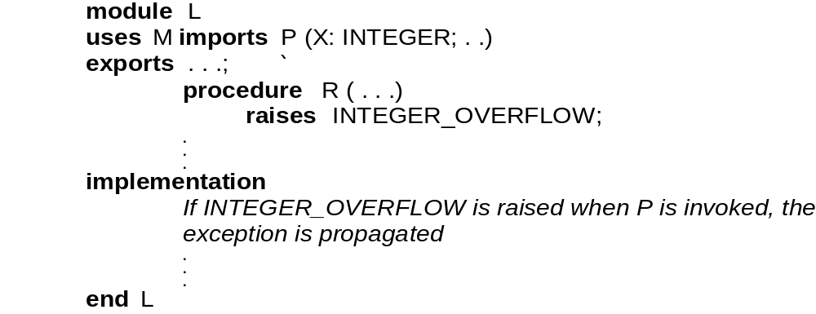
Module L
Notes:
module L uses module M
Should the exception INTEGER_OVERFLOW occur when procedure P is called by procedure R of L, we might decide that R‘s handler will do some cleanup and bookkeeping and then raise an appropriate exception (perhaps IN'I‘EGER_OVERFLOW again) to be handled by M’s client. The same policy might also be followed by the client, and so on. Indeed, this can be a way of performing an organized shutdown of the system as a consequence of an unrecoverable error.

Slide 94
A Further Relation: Inheritance (Generalization – Specialization)
The keyword in (pure) object-oriented design: “inheritance” - to form a class of objects.
  e.g., “class” in C++ (public, private, protected)
  e.g., “extends” in Java creates “subclasses”
ADTs may be organized in a hierarchy
Class B may specialize class A
  B inherits from A
conversely, A generalizes B
A is a superclass of B
B is a subclass of A
Notes:
OO design allows abstract data types to be organized in a hierarchy through generalization-specialization relations. Such a hierarchy defines a classification scheme for abstract data types.
If class B specializes class A (conversely, A generalizes B), then the abstract data type implemented by B defines objects that behave like A’s instances, but may provide more methods and attributes. Thus, all methods and attributes defined for A can be used to manipulate B’s objects (which also may be ‘manipulated by the methods and attributes defined specifically for B).
B is said to be a subclass of A, with A being B’s superclass.

Slide 95
Key Concept in O-O Design: Inheritance
A new relation: INHERITS_FROM
If M₁ INHERITS_FROM M₂, then M₁ has visibility into the internal structure (the __secrets__) of M₂
  a hierarchy relation
    __irreflexive______
    _____________________
    _____________________
  M₁ INHERITS_FROM M₂
    M₂: parent module
    M₁: heir module
Notes:
Generalization-specialization can be implemented in a straightforward way through the inheritance mechanism provided by OO programming languages. This is why we often say “M₁ inherits from M₂" as a synonym of “M₂ specializes M₂” Accordingly, we can also say that M₂ is M₁ 's heir class and M₁ is M₂’s parent class.
Recall if class M₂ specializes class M₁ (conversely, M₁ generalizes M₂), then the abstract data type implemented by M₂ defines objects that behave like M₁’s instances, but may provide more methods and attributes. Thus, all methods and attributes defined for M₁ can be used to manipulate M₂’s objects (which also may be ‘manipulated by the methods and attributes defined specifically for M₂).

Slide 96
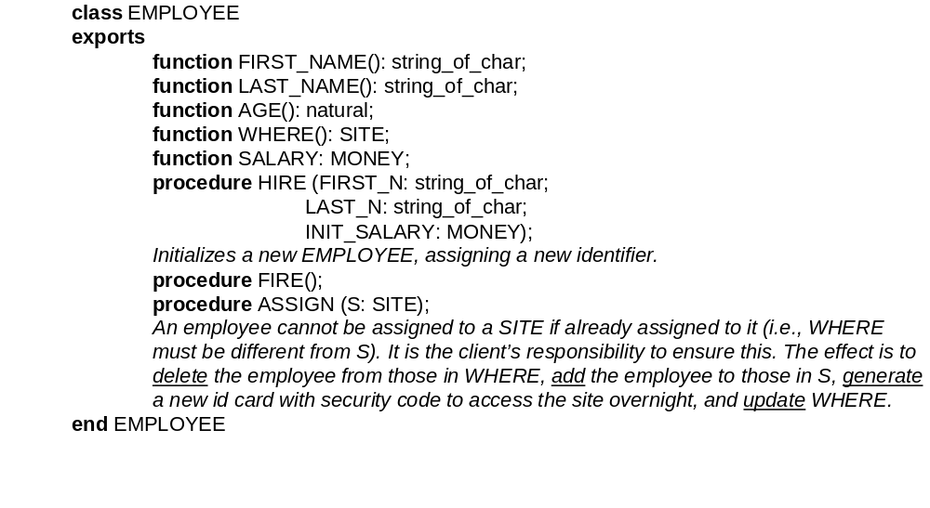
An Inheritance Example in TDN
Figure 5.9 An Example of Inheritance: TDN
Notes:
As an example, consider class EMPLOYEE defined in TDN. Class EMPLOYEE defines what is common to any kind of employee. All instances of EMPLOYEE (representing individuals) are characterized by the operations provided by the class for manipulation of the instances. For example, an employee instance may be hired with an initial salary, by which it receives a unique identifier; it may be fired, by which the unique identifier is released; it may be assigned to a work site of the company, it may be promoted, and it may be queried for its name, age, salary, unique identifier, etc.

Slide 97
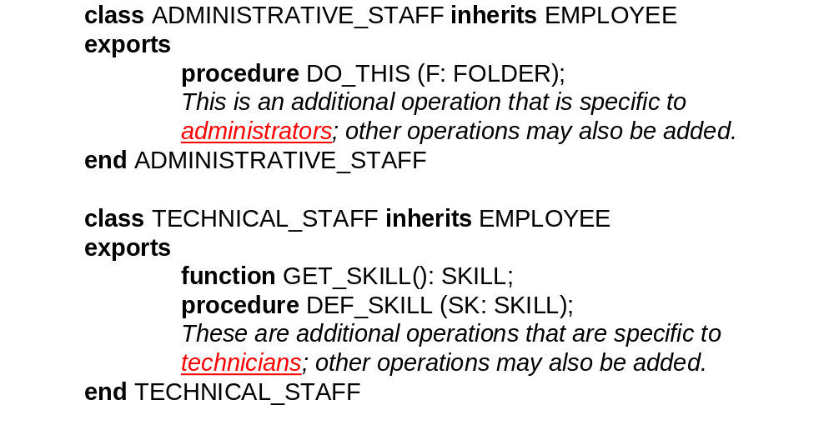
Figure 5.9 An Example of Inheritance: TDN
Notes:
Some employees are members of the technical staff, others are members of the administrative staff, and still others are a member of neither staff. For this purpose, we define in Figure 5.9 two subclasses: TECHNICAL_STAFF and ADMINISTRATIVE_STAFF. A member of the administrative staff enjoys all properties of employees: indeed, he or she is an employee!
From an abstract data-type viewpoint, this means that the corresponding objects may be manipulated by all operations defined by the parent class EMPLOYEE, as well as others that characterize the heir module itself. In OO terminology, we say that ADMINISTRATIVE_STAFF inherits automatically all methods and attributes defined from EMPLOYEE

Slide 98
An Example of Inheritance: GDN
... to modules MONEY
uses
exports
NAME
AGE
WHERE
Module EMPLOYEE
Module SITE
_____________________
DO_THIS
Module
Module
GET_SKILL
DEF_SKILL
ADMINSTRATIVE
TECHNICAL
exports
STAFF
STAFF
________
________
Module
FOLDER
Module
SKILL
Notes:
Here is an example of inheritance depicted by GDN. Three modules are the same as discussed previously by TDN.
We use directed arrow to represent inheritance relationship.
Note the different usage of directed arrow in GDN. It could represent export, uses relationship and inheritance relationship.

Slide 99
Properties of Inheritance
Inheritance allows a hierarchical classification scheme for abstract data types through generalization-specialization relations
  distinguish commonalities and differences among a (potential) set of abstract objects
  commonalities are factored out in a __parent_ class
  variations are singled out in the __heir(child)__ classes
Notes:
From a software design perspective, generalization-specialization may be used to factor out in a parent class what is common to different components, and then single out the variations in heir classes.
We may try to factor out in a module all features that are likely to be sufficiently general to be reusable.
The additional features needed in specific applications may be added afterwards by means of heir modules.

Slide 100
Properties of Inheritance
Inheritance improves reusability - ___parent__ class
Inheritance is a way of building software __incrementally__
Disadvantage of inheritance
Notes:
Generalization-specialization may be used to factor out in a parent class improve reusability
We can also look at inheritance as a way of building software incrementally.

Slide 101
Properties of Inheritance
A subclass defines a subtype
  subtype is substitutable for parent type
Polymorphism
  a variable referring to type A can refer to an object of type B if B is a subclass of A
Dynamic binding
  the method invoked through a reference depends on the type of the object associated with the reference at runtime
Notes:
An heir class as implementing a subtype of the type defined by its superclass. An element of a subtype should be allowed to appear wherever a member of its parent type may appear. This is often called the substitutability principle.
Suppose now that some code manipulates an object X of type B. If the method for promotion is invoked on X, then, since X is bound to an instance of class A, the method for promotion redefined in class A is actually called.
The important concepts behind this approach are polymorphism and dynamic binding.
Since X is an object of type B, we can bind it to, objects of any of its subtypes (polymorphism), and the methods that get invoked depend on the type of the object that is bound to X at run time (dynamic binding)

Slide 102
Several (Controversial) Extensions
Redefinition: an heir product provides a different implementation for one of its parent’s services
  e.g., change of the sorting algorithm regarding its implementation (no change to interface)
  _______ and _________ allow it; ________ does not
Redefinition applied to the data structure hidden in the parent module
Multiple inheritance: define a new module by combining the feature provided by two or more parent modules
  e.g., FIFO_QUEUE, EMPLOYEE
  ________ allows it, but _________ and _________ do not
Notes:
There are several (controversial) extensions defined in OO design:
Redefinition: an heir product provides a different implementation for one of its parent’s services
e.g., change of the sorting algorithm regarding its implementation (no change to interface)
C++ and Smalltalk allow it; but Java (old version) does not
Redefinition applied to the data structure hidden in the parent module
Multiple inheritance: define a new module by combining the feature provided by two or more parent modules
e.g., FIFO_QUEUE, EMPLOYEE
C++ allows it, but Smalltalk and Java do not

Slide 103
Using UML in Software Design
UML (Unified Modeling Language) notation is popular in software engineering.
UML is a collection of languages that provide specific notations to specify, analyze, visualize, construct, and ________ software.
UML is a widely adopted standard notation for representing OO designs
We introduce the UML class diagram
  classes are described by boxes
Notes:
UML notation, where classes are represented by boxes divided into three parts——corresponding to the class name, attributes, and methods and the generalization-specialization relation is represented by a triangular connector between classes

Slide 104
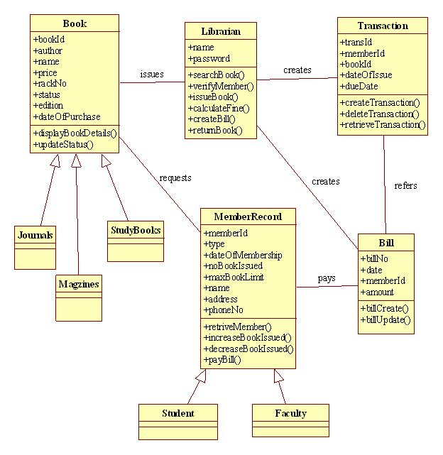
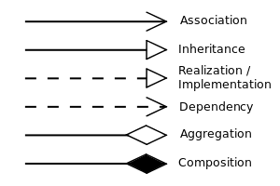
Class Diagrams Notation and Example
Class member visibility
+ | Public
- | Private
# | Protected
/ | Derived
~ | Package
UML relations notation
Notes:
This slide shows sample UML class diagrams for a library system.
To specify the visibility of a class member (i.e. any attribute or method), these notations must be placed before the member's name: public, private, protected, derived (can be combined with one of the others), and package.
Instance-level relationships includes Association, Inheritance, Realization/Implementation, Dependency, Aggregation, and Composition.

Slide 105
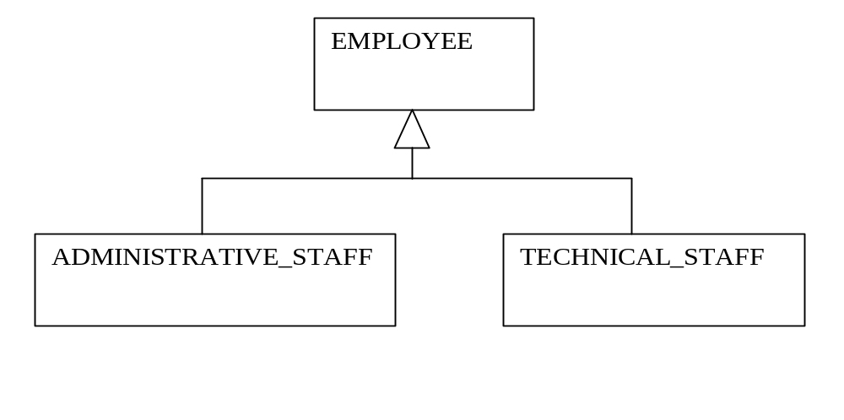
UML Representation of Inheritance
Note: similar to __________
Notes:
This figure shows a UML description of the textual representation shown previously. Observe that the uses relation between classes is not shown explicitly. Rather, it is implicit in the fact that the types of certain attributes or method parameters are not elementary, but are defined by other classes (which are therefore used).

Slide 106
UML Associations
Associations are relations that the implementation is required to support
Can have multiplicity constraints
TECHNICAL
1
PROJECT
_STAFF
*
project_member
1..*
manages
MANAGER
1
Notes:
Associations represent relations that the implementation is required to support between instances of classes. For example, members of the technical staff may be associated with the project they are working on. (Each technician works on exactly one project, but several technicians may work on the same project)
In general, multiplicity constraints are given by specifying “lower bound . . upper bound”. The abbreviation “*” actually stands for “0 . . infinity", and “1” stands for “1. .1”.

Slide 107
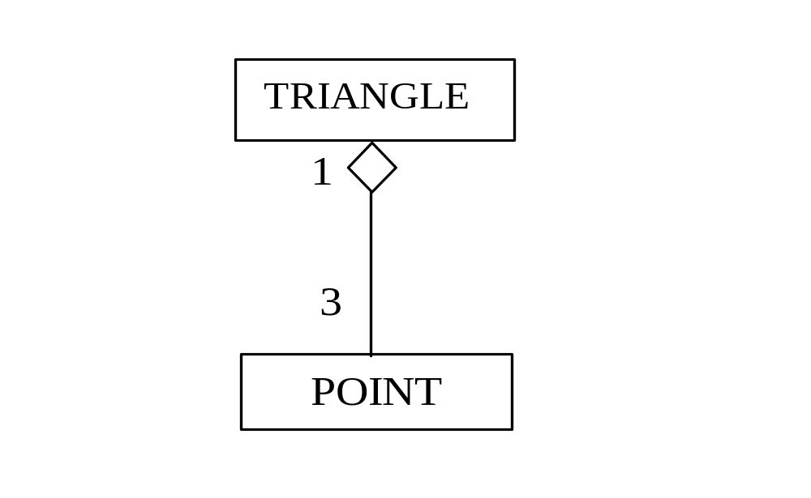
UML Aggregation
Defines a PART_OF relation
Differs from IS_COMPOSED_OF
Here TRANGLE has its own methods
It implicitly uses POINT to define
its data attributes
Notes:
In describing a class, it may be useful to define the objects of that class as composed of simpler components that constitute the parts of those objects. This is often called the PART_OF relation.
Notice that the PART_OF relation differs from the Is_COMPOSED_OF relation. In fact, the component that comprises the parts has its own properties which are not directly provided by the parts. Rather, the component uses its parts to provide its own behaviors (i.e., attributes and methods).
The class TRIANGLE provides the methods and attributes needed to manipulate triangles, represented as three references to objects of class POINT. Thus, implicitly, this says that TRIANGLE USES POINT.

Slide 108
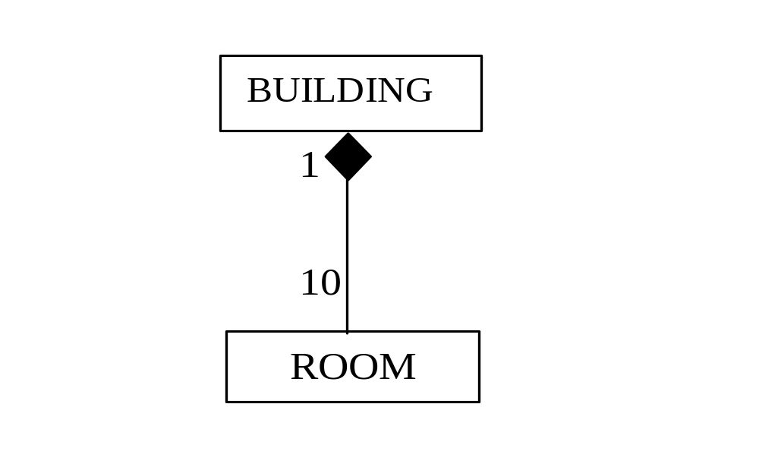
UML Composition
Defines a HAS relation
Here BUILDING HAS 10 ROOM objects, or
ROOM is owned by BUILDING.
Main difference between aggregation and
composition?
Notes:
In describing a class, we can also define the objects of a class as composed of other simpler objects, which complete “own” them. This is often called the HAS relation. This is UML composition, sometimes called composition association, as comparing with aggregation association described in the previous slide.
Notice that the composition association differs from the aggregation association in the sense that in composition association, objects owned by the other side cannot exist by themselves, while in aggregation association, objects of both side can have their own life cycles.
The class BUILDING is composed of 10 ROOM objects. If the BUILDING is deleted, all the ROOM objects are deleted.

Slide 109
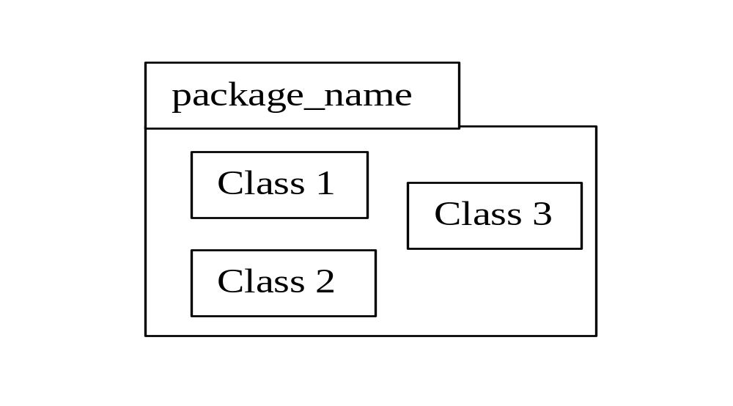
More on UML
UML evolves from TDN/GDN
USES relationship is refined with semantically richer relationship: inheritance, association, and aggregation
  If class B inherits from class A, B USES A => ___________ USES _________
  Association between classes implicitly define USES relation => ___________ USES ____________
  If B aggregates A, B USES A => __________ USES __________
Representation of IS_COMPONENT_OF via the package notation
Notes:
UML class diagrams can be seen as an evolution of the simple GDN we introduced earlier for documenting designs.
The USES relationship we introduced for GDN is replaced by la variety of relations: generalization-specialization, associations of various kinds, and aggregation. In all cases, USES relations are implied.
If a class B inherits from class A, B USES A.
If an association exists between classes A and B, with a navigability constraint indicated from B to A, then B USES A.
If B is described as an aggregation of A, then again, B USES A.
UML also provides a notation to describe the IS_COMPONENT_OF relation: the package construct. The package groups several classes or packages

Slide 110
Software Architecture
Describes overall system organization and structure in terms of its major constituents and their interactions
Standard architectures can be identified
  pipeline
  blackboard
  event based (publish-subscribe)
Notes:
An architecture of a system describes the overall organization and structure of the system in terms of its major constituents and their interactions.
By studying existing systems, designers and researchers have found that certain architectures occur frequently.
pipeline
blackboard
event based (publish-subscribe)

Slide 111
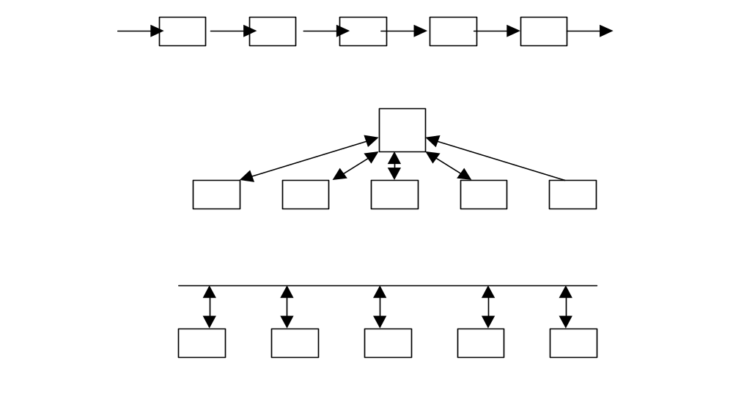
Standard Architectures
Pipeline
Example: _________________
Blackboard
Example: ____________ ,
_________________
event based
Example: _______________
_______________________
Notes:
Pipeline architectures. Sometimes, subsystems may be organized to form a pipeline of processing elements Each subsystem accepts input from the previous subsystem, processes the input, and delivers output to the next subsystem. The first subsystem reads the system input, and the last subsystem produces the system output.
Such an architecture may be useful, for example, for the part of a plant-monitoring system in which sensors read environmental data and pass them on to other subsystems for further processing.
Blackboard architecture. In this architecture, one subsystem is designated as the “blackboard” and serves as the communication medium among the other subsystems. Essentially, the blackboard is an interfaces for writing information and receiving queries.
A stock market brokerage system or an auction system may be structured as a blackboard system, with requests and offers posted to the blackboard and clients querying the blackboard for information.
Event-based architecture. In an event-based architecture, components respond to the occurrence of events. An event might be the detection of a signal by a sensor or the arrival of a message. Components are designed to create events or start their operations when they receive an event. Event-based architectures are appropriate when components wait for input from the environment or when clear client-server relationships are not definable.
User interfaces are often structured to utilize mouse clicks or mouse drags as events.

Slide 112
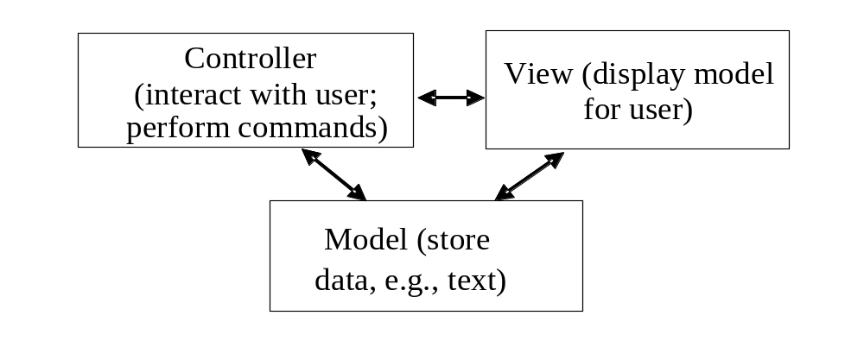
Domain Specific Architectures
"model–view–controller" architecture for software
that has a significant amount of user interaction
Notes:
Here we introduce domain-speciﬁc architectures.
One well-known domain-specific architecture is the model-view-controller for software that has a significant amount of user interaction. The architecture is composed of three separate components: the model, which purports to be a model of the “real world," the view, which displays the model to the user, and the controller, which communicates with the user and controls the other two components.

Slide 113
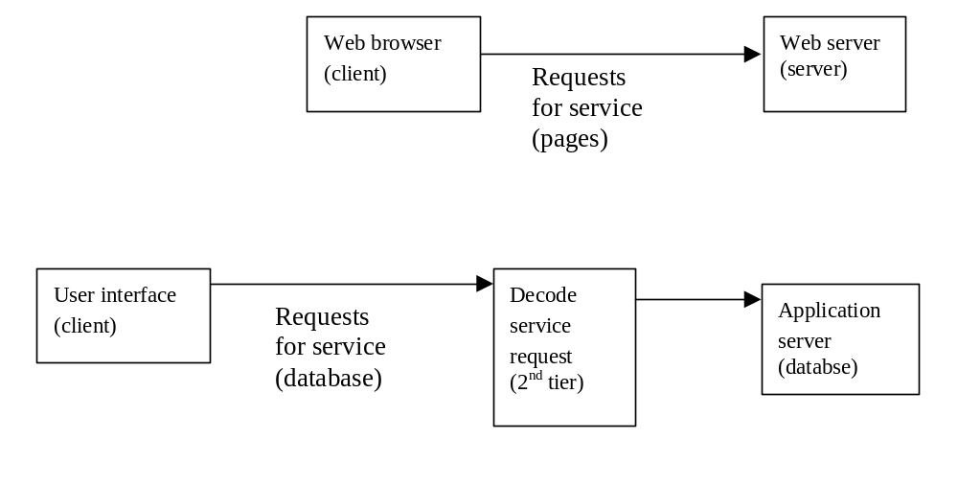
Architectures for Distributed Systems
From two tiered
  Client-server
to three tiered
Notes:
In a client-server architecture, there are two levels of components: the client level and the server level.
The client level relies on the services of the server level‘. For example, the World Wide Web (WWW) architecture exhibits this structure.
In many distributed applications, however, we may distinguish a third layer of functionality.
We can characterize such applications as three tiered, consisting of the client tier, which run the user interface; the business logic layer, which interprets the user’s requests and determines what is to be done; and the application tier, which actually performs the requested service. The application is often, but not always, a database server.

Slide 114
Program Implementation Techniques
Programming Standards and Procedures
  Need for standards and procedures
  A uniformed good programming style helps understandability, consistency, correctness of a team project.
  Standards for You
  Standards and procedures help you __organize__ your thoughts and avoid mistakes; they also help in __translating___ design to code
  Standards for Others
  It is essential you organize, format, and document your code to make it easy for others to understand what it does and how it works.
Notes:
There are several program implementation techniques which will be described in this and the following slides.
There is a need for Standards and Procedures
A uniformed good programming style helps understandability, consistency, correctness of a team project.
The standards are for You
Standards and procedures help you organize your thoughts and avoid mistakes; they also help in translating design to code
The standards are also for Others
It is essential you organize, format, and document your code to make it easy for others to understand what it does and how it works.

Slide 115
Program Implementation Techniques
/****************************************
* MODULE TO FIND INTERSECTION OF TWO LINES
* MODULE NAME: FINDPT
* PROGRAMMER: HU-AIM EYE
* VERSION: 1.0 (3 MARCH 20)
*
* PROCEDURE INVOCATION:
* CALL FINDPT (A1, B1, C1, A2, B2, C2, XS, YS, FLAG)
*
* INPUT PARAMETERS:
* INPUT LINES ARE OF THE FORM
* A1*X + B1*Y + C1 = 0 AND
* A2*X + B2*Y + C2 = 0
* SO INPUT IS COEFFICIENTS A1, B1, C1 AND
* A2, B2, C2
*
* OUTPUT PARAMETERS:
* IF LINES ARE PARALLEL, FLAG SET TO 1.
* ELSE FLAG = 0 AND POINT OF INTERACTION
* IS (XS, YS).
*****************************************/
Matching _design__ with __Implementation__
  Direct correspondence between the program design modules and the program code modules
  Keep up with the good design for traceability and maintainability
  Use header file to trace module design
Notes:
Matching Design with Implementation
Direct correspondence between the program design modules and the program code modules
You should keep up with the good design for traceability and maintainability.
Cultivate the habit of using header file to trace module design

Slide 116
Program Implementation Techniques
Programming Guidelines
  Control structures
  Algorithms
  Data structures
  General guidelines
Notes:
We offer some guidelines of how to do programming separately:
Control structures
Algorithms
Data structures
General guidelines

Slide 117
Control Structures
Using Fundamental Constructs
Main ingredients for structured programs:
      __Sequence__e.g.,__BEGIN-END__
      __Selection__e.g.,__IF-THEN-ELSE, CASE__
      ___Repetition__e.g.,___WHILE-DO, REPEAT-UNTIL__
Notes:
Control structures:
Using Fundamental Constructs
The main ingredients for structured programs are:
Sequence: BEGIN-END
Selection (condition): IF-THEN-ELSE, CASE
Repetition (loop): WHILE-DO, REPEAT-UNTIL

Slide 118
Control Structures
__Sequence__
_Selection_
Notes:
The figure shows the graph blocks of control structures:
The left one is Sequence control structure
The right one is a Selection (condition) structure

Slide 119
Control Structures
__REPEAT-UNTIL_
Do-while
___while-do
OR
Notes:
The figure shows the graph blocks of control structures:
Both are Repetition (loop) structures
The left one is do..while
The right one is while…do

Slide 120
Control Structures
Top-down Flow
  Programs should be readable from the top down
Use of Submodules
  Follow the design to build submodules (functions, procedures, macros) for elemental functions
  Build general submodules for __generality___
  Explain __interface_ of submodules, but not their details
  Q: What kind of programming destroy the structure?
  A: GOTO
Notes:
More on control structures:
The flow should be top-down
Programs should be readable from the top down
Use of Submodules for control structures
Follow the design to build submodules (functions, procedures, macros) for elemental functions
Build general submodules for generality
Explain interface of submodules, but not their details

Slide 121
Program Without Top-Down Flow
BENEFIT = MINIMUM
IF (AGE < 75) GO TO A;
BENEFIT = MAXIMUM;
GO TO C;
IF (AGE < 65) GO TO B;
IF (AGE < 55) GO TO C;
A: IF (AGE < 65) GO TO B;
BENEFIT = BENEFIT * 1.5 + BONUS;
GO TO C;
B: IF (AGE < 55) GO TO C;
BENEFIT = BENEFIT * 1.5;
C: Next statement
Notes:
Here is an example of program without top-down flow.
The program use too many go to statement which makes the program hard to understand.

Slide 122
Program With Top-Down Flow
IF (AGE < 55) THEN BENEFIT = MINIMUM;
ELSE IF (AGE < 65) THEN BENEFIT = MINIMUM + BONUS;
ELSE IF (AGE < 75) THEN BENEFIT = MINIMUM * 1.5 + BONUS;
ELSE BENEFIT = MAXIMUM;
Q1: Does JAVA allow the use of goto statement?
A1: No. Goto is a reserved keyword, but not usable.
Q2: Some languages like C, C++ still allow the use of goto. Why?
A2: for efficiency purpose.
Notes:
Here is an example of program with top-down flow.
With If..else if statement, the program is well organized. It is far more understandable than the previous one.

Slide 123
Algorithms
Program design often specifies a class of algorithms to be used
Efficiency of code should consider
  _execution time_ of code
  time to _write_ the code
  time to _test_ the code
  time for users to _understand_ the code
  time to _modify_ the code, if necessary
Notes:
What does efficiency of code mean? There are five answers to this question.
To implement some function or operations, usually there are several ways. In design there are often a class of algorithms that could be used.
Here we list five parts of the efficiency of code that the programmer should consider. The selection of algorithm is a tradeoff among all these factors.

Slide 124
Data Structures
Keeping the Program Simple. Restructuring data can simplify a program.
  Keep It Simple and Straightforward: ___KISS____
Using the Structure of Data to Determine the Structure of the Program
Localizing Input and Output in Separate Modules
Notes:
The goodness of using advanced data structure in the program is keeping the Program Simple. Via using data structures, restructuring data can simplify a program.
It is so called KISS: keep It Simple and Straightforward
The structure of data is used to determine the structure of the program.
By data structure, it is possible to localize input and output in separate modules (e.g., stack, queue).

Slide 125
General Guidelines
Using Pseudocode
Revising and Rewriting Instead of Patching
Notes:
Here are two general guidelines of program implementation:
Use the pseudo-code in design phase.
You could quickly translate the pseudo-code into target code of the implementation. Pseudo-code is representative to depict the outline as well as details of the design.
Consider revising and rewriting the code instead of patching.
Patches would often make the program hard to maintain and introduce more bugs.

Slide 126
Example of Program Simplification Using Data
Computing a tax due by:
  For the first $10,000 of income, the tax is 10%.
  For the next $10,000 above $10,000, the tax is 12%.
  For the next $10,000 above $20,000, the tax is 15%.
  For the next $10,000 above $30,000, the tax is 18%.
  For any income above $40,000, the tax is 20%.
Notes:
This is an example of program simplification using data

Slide 127
Program 1
TAX = 0.
IF TAXABLE_INCOME = 0, GO TO EXIT
IF TAXABLE_INCOME > 10,000, TAX = TAX + 1000.
ELSE TAX = TAX + 0.10 * TAXABLE_INCOME
GO TO EXIT
IF TAXABLE_INCOME > 20,000, TAX = TAX + 1200.
ELSE TAX = TAX + 0.12*(TAXABLE_INCOME – 10000.)
GO TO EXIT
IF TAXABLE_INCOME > 30,000, TAX = TAX + 1500.
ELSE TAX = TAX + 0.15*(TAXABLE_INCOME – 20000.)
GO TO EXIT
IF TAXABLE_INCOME < 40,000, TAX = TAX + 0.18*(TAXABLE_INCOME – 30000.)
GO TO EXIT
ELSE TAX=TAX+1800.+0.20*(TAXABLE_INCOME–40000.)
EXIT: END
Notes:
The implementation of the previous problem.

Slide 128
Program 2
Build a Sample Tax Table First:
Bracket Base Percent
0 0 10
10,000 1000 12
20,000 2200 15
30,000 3700 18
40,000 5500 20
The Program:
LEVEL = 1
FOR I = 1 TO 4 DO
IF __TAXABLE_INCOME > BRACKET(I)__
THEN __LEVEL = LEVEL + 1____
TAX = __BASE(LEVEL) + PERCENT(LEVEL) * (TAXABLE_INCOME – BRACKET(LEVEL))____
Notes:
One more program that implements the problem.
First a table is build and the data is stored in an array in the memory. Then a loop is used to find the related bracket. And the tax could be calculated accordingly.
What is the advantage of Program 2 over Program 1?
Better design – more clear, shorter
Better maintenance – if there is update on requirement about tax brackets and tax rates, only need to change the Tax Table. You don’t even need to recompile the program!

Slide 129
Program Implementation Techniques
Documentation
Internal Documentation (documentation associated with the program code)
  Header Comment Block
  Other Program Comments
    I3 = I3 + 1; % increment I3
    I3 = I3 + 1; % set counter to read next case
  => case_counter = case_counter + 1;
  Meaningful Variable Names and Statement Labels
  weekage = (hr_rate * hours) + 0.5 * hr_rate * (hours – 40);
  vs
  Z = A * B + 0.5 * A * (B -40);
Notes:
Documentation is an important activity for program implementation.
Internal Documentation (documentation associated with the program code). We list five ways of internal documentation:
Header Comment Block
Other Program Comments
I3 = I3 + 1; /* INCREMENT I3 */
I3 = I3 + 1; /* SET COUNTER TO READ NEXT CASE */
=> CASE_COUNTER = CASE_COUNTER + 1;
Meaningful Variable Names and Statement Labels
WEEKAGE = (HRRATE * HOURS) + 0.5 * HARRATE * (HOURS – 40) vs Z = A * B + 0.5 * A * (B – 40)

Slide 130
Header Comment Block
Specify 6 W’s
  _What_ your program is
  _Who__ wrote the program
  _How__ the program fits in the general system design
  _When_ the program was written and revised
  _Why_ the program exists
  _Where_ your program uses its data structures, algorithms, and control
Notes:
For Header Comment Block, there are 6 W’s to be specified:
What your program is
Who wrote the program
Where the program fits in the general system design
When the program was written and revised
Why the program exists
How your program uses its data structures, algorithms, and control

Slide 131
Sample
_What_
_Who_
_Where_
_When_
_Why_
_How_
PROGRAM SCAN – Program to scan a line of text for a given character
PROGRAMMER: Wan, Lai-man 3943 8481
CALLING SEQUENCE: CALL SCAN(LENGTH,CHAR)
Where ‘LENGTH’ is the length of the line to be scanned, ‘CHAR’ is the character to be sought, line of text passed as array ‘NTEXT’
VERSION 1: written 2-2-2020
REVISION 1.1: 3-3-2020 to improve searching algorithm.
PURPOSE: General-purpose scanning module to be used for each new line of text, no matter the length.
DATA STRUCTURES: Variable LENGTH – INTEGER
Variable CHAR – CHARACTER
ARRAY NTEXT – CHARACTER array of length ‘LENGTH’
ALGORITHM: Reads array NTEXT one character at a time;
if CHAR is found, position in NTEXT returned in variable ‘LENGTH’; else variable ‘LENGTH’ set to 0
Notes:
Here is a sample Header Comment Block.

Slide 132
Program Implementation Techniques
  Formatting to Enhance Understanding
    _Use indentation________________
    __Separation code ___
  Documenting Data
    ___Data structures are sometimes the hardest part of a program_______
Notes:
Internal Documentation (documentation associated with the program code). We list five ways of internal documentation:
Formatting the code to enhance understanding
Use indentation in the code
Separate code and comments to two sides
Documenting Data
Data structure are sometimes the hardest part of a program, provide documenting/comments on the data structure would help understanding the code

Slide 133
Program Implementation Techniques
External Documentation
  Describing ____Problem______ (what)
  Describing ___Algorithms____ (how)
  Describing ____Data________ (how)
Notes:
External Documentation (documentation apart from the program code). We highlight three things that should be mentioned in external documentation:
Describing Problem
Describing Algorithms
Describing Data

Slide 134
Topic 5 Conclusion
Software design: from specification description models to design description models
Software design activities and modularization techniques
Overall structure design
  Hierarchical relations, uses relation, is_component_of relation
  Interface and information hiding
Detailed design
  TDN, GDN, category of modules, stepwise refinement
Handling anomalies
Inheritance
UML for software design
Program implementation techniques
Notes:
Rigor and formality have been shown to be essential goals of our design documentation, inspiring the definition of a design notation that was presented in two forms: textual (TDN) and graphical (GDN). Such notation provides a clear way of documenting a software design, to facilitate communication among software designers and future maintainers of the system.
Software design involves transforming specification description models (process spec., control spec., data object descriptions, which include DFD, FSM, PN) to software design description models (data structure design, architecture design, interface design, components/procedures design)
We have shown that design consists of
defining an architecture in terms of a set of relations on modules
defining the interfaces between the modules.
These activities may be driven by the general principles that the architecture should have low coupling and high cohesion and that interfaces should enforce information hiding.
Information hiding was assumed as a cornerstone upon which a solid design is based.
In particular, we identified several categories of modules that may be used as guidelines during design. Most notable were abstract objects and abstract data types.
We also revisited the concept of stepwise refinement, a widely used technique for implementation.
Among the qualities of software design, we stressed evolvability and reliability. We also addressed the issue of defensive design, by showing that possible anomalies should be considered during the design phase and described in the documentation.
We addressed the issue of design for concurrent software and synchronization issues, by extending the design principles and the proposed design notation to these cases.
We discussed about OO design, particularly relating to the concept of inheritance.
UML used in software design is further described.
Finally, we talked about program implementation techniques.

